Slide 1

The micro-dynamics of power in focus group discussions with the South Sudanese diaspora in the UK
@RachelAyrton
University of Southampton

Slide 2
Who are inclusive, participatory and emancipatory research methods for?
What assumptions do we make about power in research interactions with them?

Slide 3


Challenging assumptions about power in research
Is Power … | OR …
Pathological | Inevitable
A procedural problem | Observable
Invested in certain actors (and not others) | Circulating

Slide 4
Outline
The place of power in focus group discussions
The study
Theoretical framework: Bourdieu’s notion of fields
  Rules of the game
  Stakes of the game
  Boundaries of the field

Slide 5
Interaction and power in focus group discussions
Mainstream view: interaction produces content
  Power sabotages interaction and causes ‘problem behaviour’.
  Power should be minimised by recruiting ‘homogeneous’ participants and through facilitator control strategies.
  (Krueger 1998; Krueger and Casey 2015; Stewart and Shamdasani 1990; Greenbaum 1998; Bloor et al. 2001; Carey and Asbury 2012)
Counter-current: interaction analytically interesting in its own right
  Focus groups provide the opportunity to observe patterns of interaction … and power?
  ‘Interactions can make groups seem unruly . . . but such ‘undisciplined’ outbursts are not irrelevant or simply obstructive to the collection of data . . . Everyday forms of communication . . . may tell us as much, if not more, about what people ‘know’.‘ (Kitzinger, 1994: 109; Wilkinson 1998, 2004; Madris 2000; Duggleby 2005; Halkier 2010)

Slide 6

The Study

Slide 7

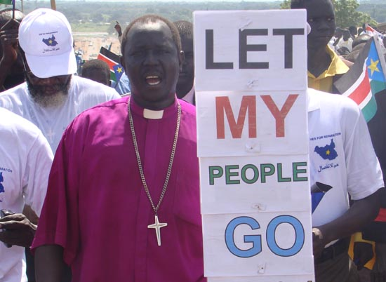

Slide 8
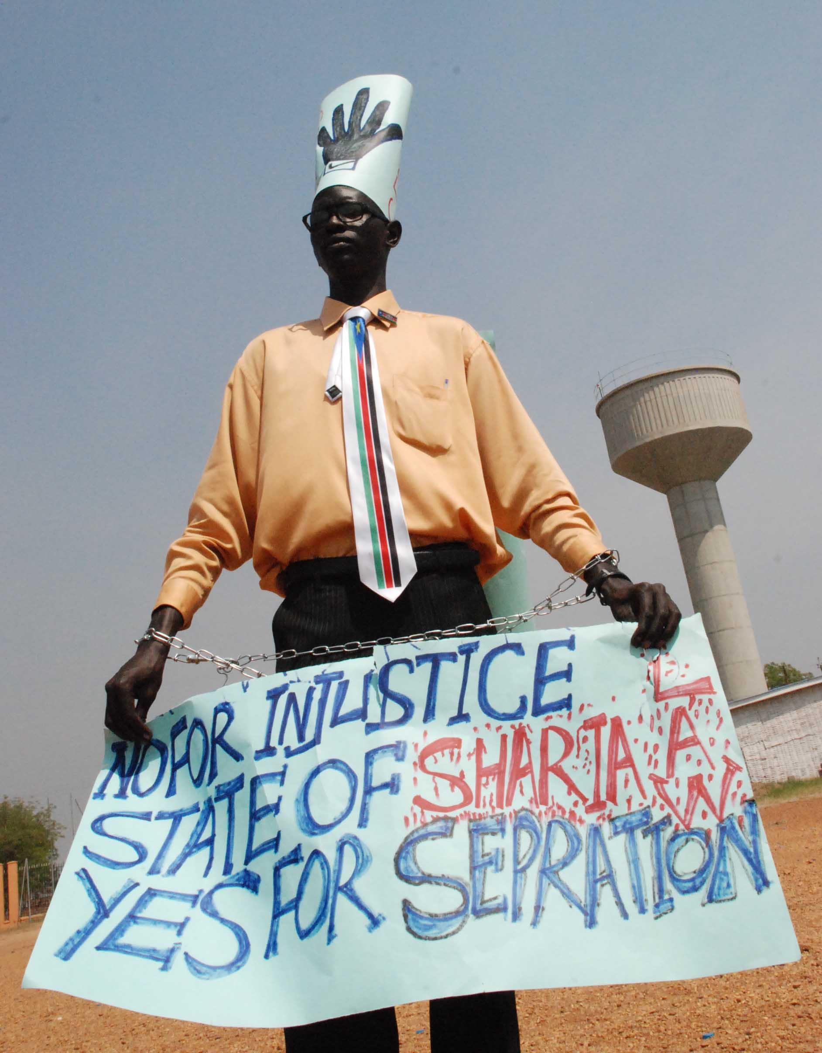


Slide 9
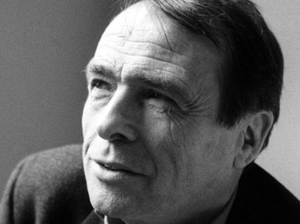
Theoretical approach: Fields of power
“An ensemble of invisible relations, those very relations which constitute a space of positions external to each other and defined by their proximity to, neighbourhood with, or distance from each other, and also by their relative position, above or below or yet in between, in the middle.” (Bourdieu, 1989: 16)

Slide 10
Fields of power
Multi-level, “nested” sites of struggle which operate semi-independently at four levels:
Field of power
General Field | National community (South Sudanese citizens)
Specific field | South Sudanese diaspora in the UK
Agents within that field | Focus group members

Slide 11
Three aspects of fields:
Defending, contesting and relinquishing the rules of the game
Negotiating the stakes of the game
Mobilising boundaries of the field

Slide 12
Defending, contesting and relinquishing the rules of the game
The specific logic of practice within a particular field is governed by rules, or ‘regularities.’
Players “accord … that what happens in it matters, that its stakes are important … and worth pursuing.” (Bourdieu & Wacquant 1992: 116)
In a focus group discussion, the researcher/facilitator hopes that participants will be “taken in by the game” of knowledge co-production and will “collude” in its construction (Bourdieu & Wacquant 1992: 98)

Slide 13
Bel Pen: I haven’t finished. You want me to finish, or that is okay?
Rachel: Oh, yeah, if you want to say something [particularly about that image …
Bel Pen: [Because I was never allowed to finish … My contribution
Rachel: I’m sorry – it’s because we have a limited time, you know?
Bel Pen: (laughs)
Paul: When you hear the record here (gestures to voice recorder) you are the one, [your voice is …
Bel Pen: [It’s not about the time you are talking, it is about how much can you give as a good contribution to this research … for example. And if you cannot definitely when you talk more it means you have more information. And if you talk less it means you are satisfied with the few information that you give. So here ….
John: That’s an interesting way of looking at it Bel Pen.
(laughter)
John: But carry on.
Rachel: We can maybe debate that one later – tell us about that picture.
Bel Pen: Really, these little girls here [Amos: Yeah; Rachel: Yeah] had the feeling like me that this means peace, it means there will be no bombing, no fighting, nothing at all […] And she was right, and she was right. Whatever happened after that, whatever war you guys had done after that, that was not in, in, in her mind, completely. She was free, she was free like me, on that day.
Amos: Good point.
John: Mmhmmm.

Slide 14
Allowing space for power: facilitator control
If a focus group practitioner wishes to observe the dynamics of power, should s/he:
Enforce the ‘rules of the game’?
Make exceptions to them?
Adapt them?
Need to have clear awareness of the parameters s/he is imposing, apply them flexibly, and open as many as possible to negotiation with participants.

Slide 15
Negotiating the stakes of the game
Fields are arenas of struggle for valued resources, or ‘capitals,’ the relative value of which differs between fields.
It is this process of valuing that differentiates between fields and between agents within fields (Grenfell and Hardy, 2007)
Participants in focus group discussions draw on resources which confer (or diminish) either their or others’ authority to speak.
Observing these sheds light on the relations of power in the general field.

Slide 16
Liz: This er, joint monitoring and evaluation [¹commission – they are not doing it because (Public figure A) [²is threatening them.
Shola: [¹Ah they are not doing anything
Cynthia: [²They are not doing anything
Shola: (Public figure A) is threatening them.
Liz: They are threatening them.
Nyanpath: Eh!
Liz: They are doing nothing.
Shola: (Public figure A), (Public figure B), er … and that, that other one.
Nyanpath: (Public figure C)
Lamba: Mama mama you are really clever, you know all of them! Me I don’t know anybody!

Slide 17
Negotiating the stakes of the game
Oliba: But now, we are alone, we’re still suffering, I don’t know until when. Me myself I don’t, because I am non-educated, I am non-politician, I’m talking as a primitive woman. But, without primitive, who can vote you to come as a President? Those people without an education is the one, they use it. And then brought them up.

Slide 18
Allowing space for power: rethinking homogeneity
General guidance recommends that participants are ‘homogenous’ in key respects, so that they are more likely to relate to each other and share more through their perceived similarity (Greenbaum, 1998; Carey and Asbury, 2012).
However, sanitises discussions of the competition over resources that would ordinarily take place.
‘Commonality’ a better principle of sampling than ‘homogeneity’.

Slide 19
Mobilising boundaries of the field
The specific logic of the field and those capitals legitimised in it provide clear boundaries.
Relationships of exchange exist between fields, and the boundaries of the field themselves are sites of contestation (Bourdieu and Wacquant, 1992).
In focus groups, who is present and the time that is allotted make the boundaries of the space fairly stable.
The researcher-facilitator may be positioned within, at the margins of, or outside this field.

Slide 20
Mobilising boundaries of the field
Cynthia: Aaahhhh, I have to start! (general laughter) Oh I have to start! I think it means identity. It means home. We don’t go home often [. . .] So, this is to to me the South Sudanese community here is like, er, er, a glimpse of home. You know? And um they, I, I run to them for support, just to talk the language. And, and, and I don’t have to make up myself. Like if I’m, I’m going to speak to a white lady for you for example, oh God, I have to push all these things in a cupboard in my head, so I do not have to express myself. But with them, I just feel at home.
Nyanpath: <click>
Cynthia: You understand? So, yeah, it’s everything. It’s what keeps me going. You haven’t been in a foreign land, it’s tough. Different culture. Different faith. Even all this freedom, sometimes too much freedom is, is (laughing) even scary.
Liz: Is a problem.

Slide 21
Allowing space for power: positionality
Although in some research there are benefits to the researcher/facilitator being an in-group member (Rodriguez et. al. 2011), ‘insider’ and ‘outsider’ negotiable categories.
Status of the researcher/facilitator not always as important as the way that boundaries are extended and contracted by participants, and the rhetorical work this achieves.
Participants cast me in a range of roles, including as chair, a safe third party, an ally, a witness, a conduit to a wider audience, and a student in need of instruction.

Slide 22
Conclusion
Power is an inevitable facet of social life and of the fields of power from which participants are purposively drawn.
It is not only inevitable, it is desirable for power to be manifest in focus group discussions.
Guidelines for the conduct of focus groups need to be reoriented to account for power.
Bourdieu’s theory of fields of power forms a useful theoretical framework to achieve this – there may be others.
Power-infused interaction is at the heart of what makes focus groups interesting, potent and distinctive as a research method.

Slide 23
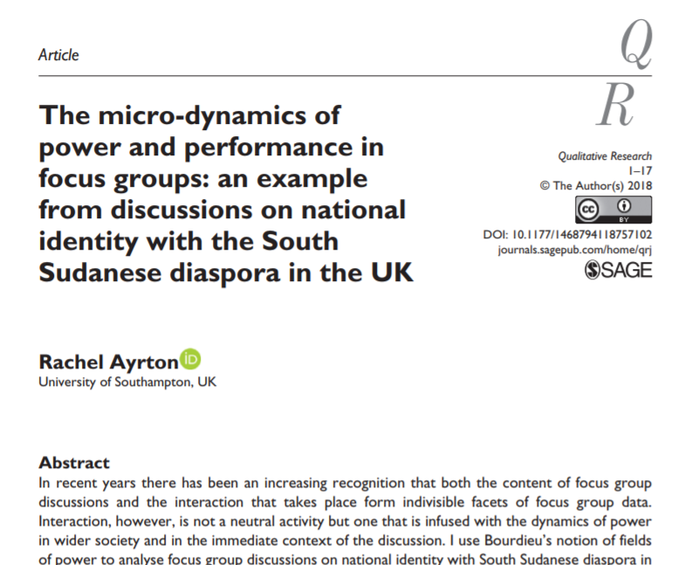
Thank you for listening
@rachelayrton
Rachel.ayrton@soton.ac.uk

