Slide 1
Introduction to Mixture and Group-Based Trajectory models
(part 1)
Dr Oliver Perra
National Centre for Research Methods
Full tutorial, and contact: https://www.ncrm.ac.uk/resources/online/all/?id=20826

Slide 2
Outline
Growth models vs. Trajectory-based groups models.
Key characteristics and parameters of trajectory-based group models.
Determining the number of groups.
Notes:
I will explain the logic of trajectory-based group models by comparing this to growth models.
I will outline the key characteristics and parameters of trajectory-based group models.
Finally, illustrate criteria for determining the number of groups.

Slide 3
Growth Models
One-size-fits-all model:
  Growth parameters, i.e. intercept (initial status) and slopes (change per unit of time) describe growth in sample.
  Assumptions about distribution of variance around growth parameters (e.g. normal distribution).
Notes:
In many studies we are interested in developmental trajectories, that is, how an outcome like a behaviour or a competence, change over time.
In many instances we may consider examples like the one represented here, where we may be satisfied that most participants follow a single trajectory on average, with some variability around this trajectory that represents sources of variation unaccounted for.
A similar trajectory is defined by parameters that describe the trajectory of the variable, called growth parameters. These parameters include an intercept, which represents the variable status at the point where we decide to start our observations, and slope parameters that represent the outcome rate of change per units of time. I will discuss these later in the presentation.
The main point here is that we use a model that we can call “one-size-fits all”, we assume that participants generally follow this trajectory, and variations across individuals' growth parameters follow a predefined distribution, for example normal distributions around the average growth parameters.

Slide 4
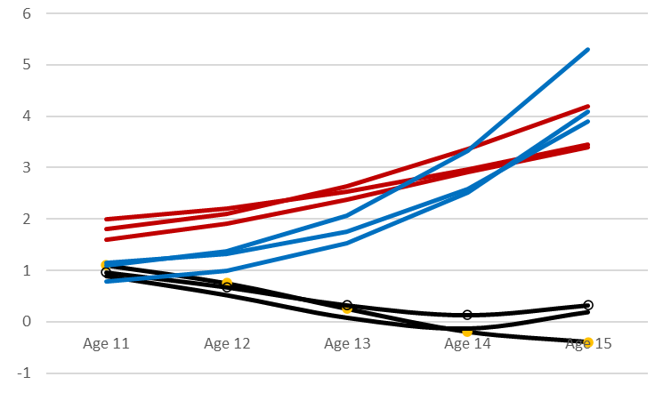
Developmental Trajector-ies
Theories in different fields (e.g. Clinical Psychology) assume heterogeneity in trajectories:
  Typical trajectory vs. Atypical trajectory.
Different trajectory groups may be associated with:
  Different aetiologies;
  Different exposures accumulating over time;
  Different susceptibility to treatments.
Notes:
In many fields theories assume that this one-size-fits-all approach is inadequate. In clinical and developmental psychology, for example, there is a long tradition of theories that assume there are typical developmental trajectories where people that do not develop significant mental health issues, but other individuals follow atypical trajectories where they display significant mental health issues at various ages, or at various times (e.g. following a traumatic event). In this graph for example, I plotted fictional data where the lines represent the trajectories of different individuals, highlighting how there may be different trajectories groups, see for example the difference between the red and the black trajectories.
Theories that assume different groups of people with different developmental trajectories sometimes assume that there may be different aetiologies, that is different causal mechanisms that explain differences in the development of the outcome, or that different trajectories are the result of exposure to different events over time. These theories often assume that these groups of individuals can respond differently to various interventions and treatments.

Slide 5
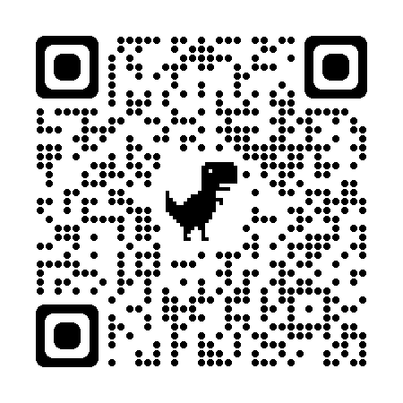
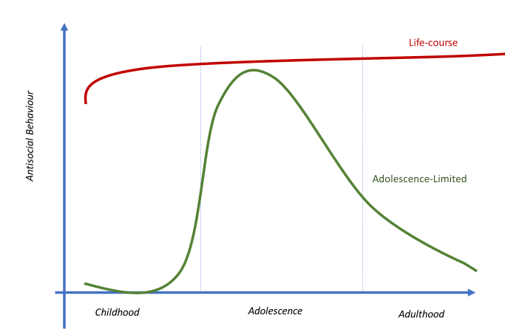
Example of Theory: Moffit (1993)
Adolescence-limited and life-course-persistent antisocial behaviour: A developmental taxonomy.
“Two distinct categories of individuals[…] with unique aetiologies”:
  A small group engages in antisocial behaviour at every age;
    Neuropsychological problems leading to cumulative risk factors.
  A larger group engages in antisocial behaviour only during adolescence;
    Mimicry and emulation of antisocial peers perceived as more independent.
Notes:
An example of a similar theory is provided by Moffit’s taxonomy of antisocial behaviour, and here you have a QR code that directs you to this paper. Moffit hypothesised that there may be two qualitatively different groups of adolescents that engage in antisocial behaviour. One small group includes adolescents that engage in antisocial behaviour from an earlier age and continue to engage in antisocial behaviour after adolescence, those represented by the red line in this graph. Moffit suggested that the causal mechanisms that lead to this life-course antisocial behaviour involve early neuropsychological problems that lead to an accumulation of risk factors, e.g. family conflict.
A larger group of adolescents, the green line here, engage in antisocial behaviour in adolescence only, and they do so because they want to emulate antisocial peers that are perceived as more independent at a time when affirming their own independence is important. Once these adolescents transition into adult roles and acquire financial and affective autonomy, they are no longer motivated to engage in antisocial behaviour.

Slide 6
Identify Trajectory Groups
Use of arbitrary criteria:
  No tests to confirm variability warrants trajectories groups.
  Cannot quantify precision of classification.
  Cannot control for error variation.
Notes:
So, how can we identify these trajectory groups?
Traditionally researchers had used arbitrary categorisation rules. In the example in this graph we plot each individual’s intercept (starting point) and estimate their variable change over time, and come up with some sensible criteria for classification.
The problems with these criteria are that we must assume a-priori that these trajectory groups exist, and we do not have formal statistical tests to check if there is enough variation in the developmental trajectories to support the existence of different trajectories groups.
Furthermore, arbitrary criteria do not provide information about the adequacy and precision of these classifications. And finally, we would rely on the observed trajectories with few means to disentangle “true” variation from error variation.

Slide 7






Mixture and Group-Based Trajectory Models
Growth Mixture Models (GMM) & Latent Class Growth Analysis (LCGA).
Person-centred approaches:
Based on probability methods:
  Test whether plausible: improvement on one-size-fits-all approach?
  Assess precision of categorisation:
    Individuals’ probability of being in one trajectory group or other.
  Distinguish random variation from real variation.
Help relax restrictive assumptions of growth models.
Notes:
A solution to these problems is provided by the development of Mixture and group based models, which I will articulate in these presentations.
I will focus particularly on Growth Mixture Models and Latent Class Growth Analysis.
These are person-centred approaches, that is, they assume that a sample is made up of a mixture of individuals with different propensities for some behaviour. The goal of these approaches is to identify a limited number of groups that ade’quately explain the variation in individuals’ trajectories we observe.
The methods I will present are based on Latent Class Analysis, and if you want to know more about this, I refer to another resource I prepared for NCRM.
These methods are based on probability methods and therefore have many advantages compared to ad-hoc rules for categorisation.
-They allow to test if a person-centred approach is warranted and provides a more adequate representation compared to a one-size-fits-all approach.
-They allow to assess the precision of the categorisation by providing probabilities of individuals being in one trajectory group or another: In this way we can check the level of uncertainty in assigning participants to trajectory groups.
-They also allow to disentangle random variation in the variables from real variation.
Finally, assuming different trajectories groups can also help relax some restrictive assumptions in one-size-fits-all growth models, as I will explain later in this presentation.

Slide 8
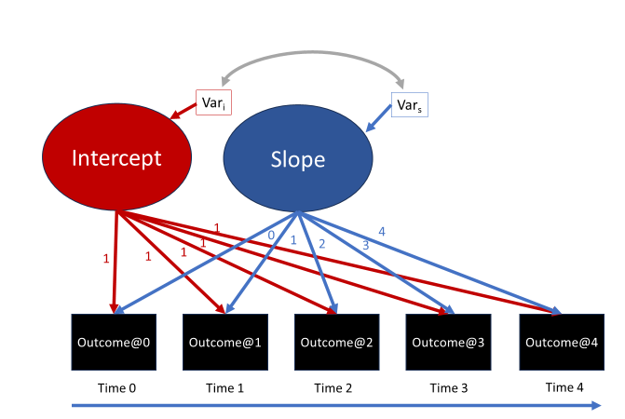
(Latent) Growth Curve Model
Variable observed over three or more occasions:
Variable can be:
  Continuous;
  Dichotomous;
  Categorical;
  Count;
Variable change over time function of parameters intercept and slope(s)
Assumptions concerning normality of variability around parameters
Notes:
Before describing the trajectory group models, I want to provide an example of latent growth curve model, which is the basis for understanding the person-centred models.
We start from an interest in longitudinal data, that is a variable collected at least on three different occasions or more. In the figure here the variable is collected over 5 occasions.
The variable can be continuous, dichotomous, e.g. depression vs. no depression, or ordered categorical, e.g. drug use from none to occasional to frequent.
Change across time can be represented by different models, e.g. multilevel regression models, but here I focus on a latent variable model. The basic idea is that we can represent the intercept, the initial status of the variable at time 0, the time we take as the start of our observations, as a latent variable. The 1s in the arrows from the intercept to the observe variables indicate that the relationship between these observed variables and the latent intercept that explains them is constant, that is, the intercept represent a value of the outcome that does not change, since it’s the level at which all individual start, on average.
The slope is a second latent variable, and explains the rate of change in the outcome. The blue numbers in the arrows from the slope to the variables represent the time factors that multiply the effect of the slope. Namely, the association between the latent slope and the variable at start of the study is multiplied by 0, meaning that the level of the variable at the start of the study is only affected by the intercept. The effect of the slope on the observed variables is then multiplied by numbers representing the increase in unit of times passing. So, if the slope is estimated as being 1.5 for example, the level of the outcome at time 1 will increase by 1.5, while it will increase by 3 (i.e. 1.5 times 2) by time 2, and so on. The slope in this case represents a linear trajectory where for every year that after the start of the study the level of the variable observed increases by a factor of 1.5 on average.
Note that these latent variables have Variance, which means that each individual display some variation, different values above or below the average initial status and rate of change. These variations can also be correlated, providing a covariance.
One assumption is usually that variation around the intercept and slope are normally distributed.

Slide 9
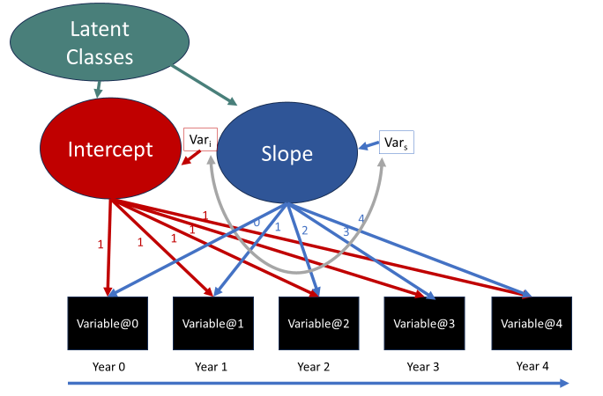
Growth Mixture Model (GMM)
Sample includes mixture of individuals with different growth parameters.
Groups not directly observed but inferred based on growth parameters:
  Latent classes
Within group variability:
  Individuals within classes vary in their growth parameters
  Residuals normally distributed within classes
Notes:
A Growth Mixture Model takes the growth model described before, but assumes that the sample is made up of a mixture of individuals that have different average growth parameters, different intercepts and slopes
These groups cannot be directly observed, but we can infer them by looking at the growth parameters of different individuals. We can thus estimate different latent classes where individuals in each class share the same propensity for displaying a certain developmental trajectory.
One important issue to notice here is that there is variance in the intra-class intercept and slopes, which means that individuals within one latent class will still display variation in their average trajectory. Within classes, the variation around the growth parameters is supposed to be normally distributed.
In other words, individuals within one class are supposed to share the same propensity for a specific developmental trajectory, and each trajectory class has its own distinctive average trajectory, but individuals within each class will also vary around this average trajectory.

Slide 10
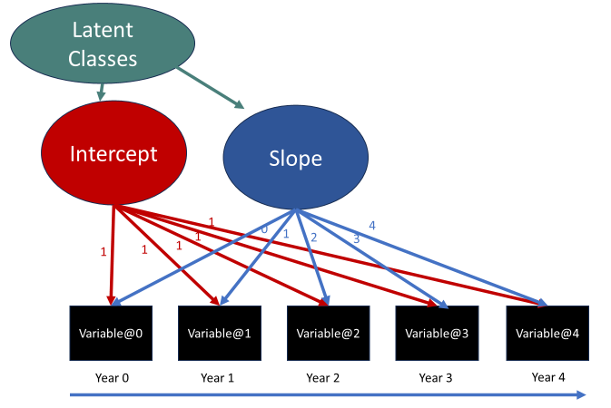
Latent Class Growth Analysis (LCGA)
Sample includes mixture of individuals with different growth parameters.
Groups not directly observed but inferred based on growth parameters:
  Latent classes
No variability within classes:
  Individuals within classes share the same growth parameters
Notes:
A LCGA will provide a similar model, one where we assume that there is a mixture of individuals in the sample, and each group or class of individuals have different propensities for distinctive developmental trajectories.
The key difference in LCGA is that we assume there is no variability within classes: all individuals within a class have the same growth parameter, follow the same developmental trajectory, with variation being only due to measurement error.

Slide 11
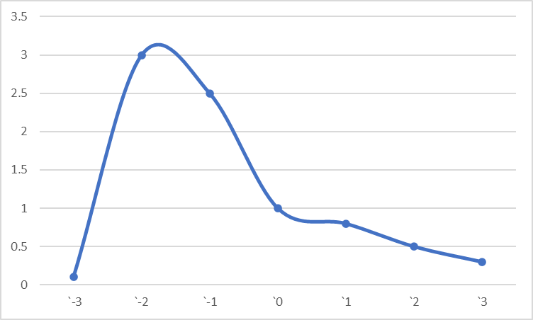
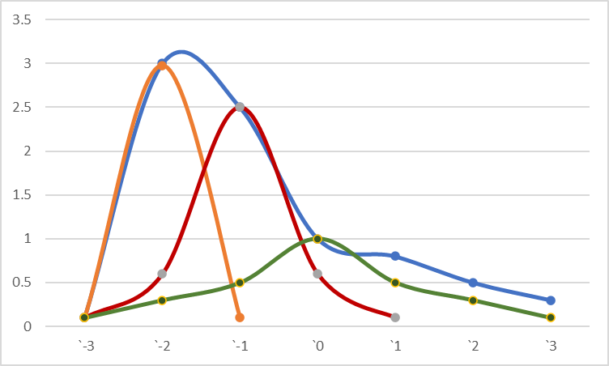
Comparison between approaches
Growth Curve Model
Latent Class 1
Latent Class 2
Latent Class 3
GMM
Notes:
The difference between the models can be illustrated by looking at these graphs. Assume that the one-size-fits-all model provides a similar distribution of a growth parameter, which, by they way, is not normal. The GMM can represent this distribution by indicating different classes that have different averages of the parameter, but they are all distributed normally around their respective average. These normal distributions represent the intra-class variation.

Slide 12
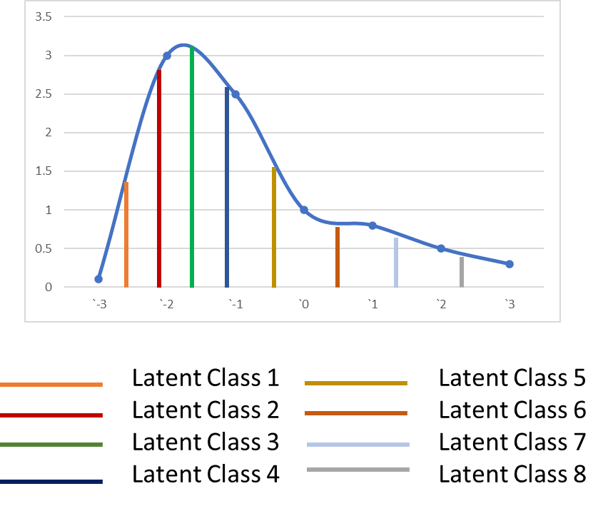
Comparison between approaches
LCGA
Growth Curve Model
GMM
Notes:
LCGA will instead represent the distribution by indicating different classes that have different parameters, but with no variation around the intra-class variation. Since there is no variation within classes, more classes will be estimated to adequately represent the full distribution, as we can see here.

Slide 13
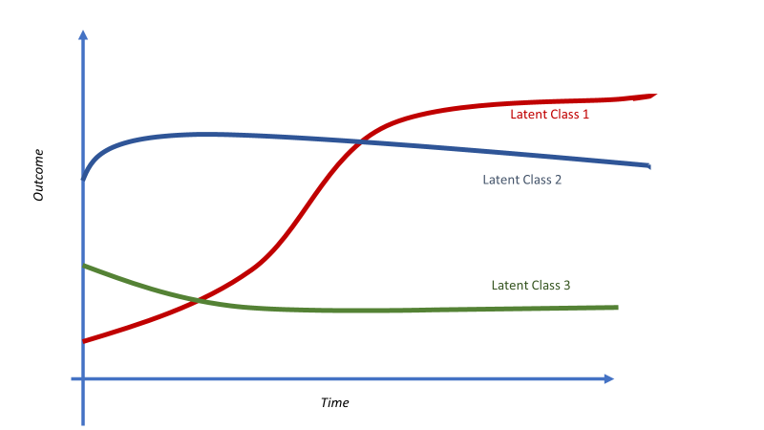


GMM and LCGA: Individual’s allocation
  Relationships between latent variables and outcomes, observed with error.
  Individuals assigned to one class or another with uncertainty.
Notes:
I want to emphasise once again that these group-based models are probabilistic, so the relationships between observed and latent variables are estimated with error. This also means that the classification of individuals in different trajectory groups is not certain, but there is some level of uncertainty, and it is important to take this into account, in particular when we want to test the association between trajectory groups and predictors, or how trajectory groups respond to treatments or predict other distal outcomes.

Slide 14
GMM and LCGA: Main Parameters
Class-specific growth parameters:
  Intercept, linear slope, quadratic slope…
Latent classes prevalence:
  Sum = 1 → Every individual belongs to only one class (Mutually Exclusive).
i1; s1; q1
45%
45%
i2; s2; q2
10%
i3; s3; q3
Notes:
This uncertainty is reflected in some of the key parameters of the models.
As well as the class-specific growth parameters represented in this figure as i, s, and q, for intercept, linear slope and quadratic slope respectively, a second key parameter is the latent classes prevalence, that is the probability that a random individual will be in latent class 1, 2 or 3. These probabilities sum up to 1, meaning that every individual is supposed to belong only to one class. In the example here, 45% of participants are estimated to belong to latent class 1.

Slide 15
GMM and LCGA: Main Parameters
Class-specific growth parameters:
  Intercept, linear slope, quadratic slope…
Latent classes prevalence;
Individual’s probability of latent classes affiliation (Posterior probability):
  Sum=1 → Every individual belongs to one class or other (Comprehensive).
i1; s1; q1
45%
45%
i1; s1; q1
10%
i1; s1; q1
Latent Class 1: 56%
Latent Class 2: 33%
Latent Class 3: 21%
Notes:
The other important parameter is individuals’ probability of being in each of the latent classes estimated, which is called the posterior probability. We can see this individual highlighted here for example has 56% probability of being in class 1, 33% of being in class 2, 21% of being in class 3. So the individual has a higher probability of being in class 1, but you can see this affiliation is not certain, and there is some margin of error. The posterior probabilities sum up to 1, which means that despite this uncertainty, each individual is supposed to belong to one class or another.

Slide 16
GMM and LCGA: Main Parameters
Class-specific growth parameters:
  Intercept, linear slope, quadratic slope…
Latent classes prevalence;
Individual’s probability of latent classes affiliation (Posterior probability):
  Entropy (0 to 1)→ Precision of latent class classification.
i1; s1; q1
45%
45%
i1; s1; q1
10%
i1; s1; q1
Latent Class 1: 56%
Latent Class 2: 33%
Latent Class 3: 21%
Notes:
The statistic entropy represents the precision of this classification. Entropy varies from 0, which represents a case where all the participants have the same probability of being in class 1, 2 or 3. Entropy 1 represents a case where all the participants are certain to belong to one class or another. So the closer the Entropy is to 1, the more precise the classification.

Slide 17
Determining the number of classes
Different statistics to consider:
  Model fit (e.g. G² );
  Information criteria (e.g. Bayesian Information Criterion – BIC);
  Likelihood-Ratio tests of n classes vs. n-1 classes (e.g. Bootstrapped LRT);
  Model residuals;
  Entropy;
Judgement: Summarise main features of data parsimoniously and successfully.
Notes:
Finally, in determining the number of trajectory classes we need to adequately represent the inter-personal variability, whether we apply GMM or LCGA, we need to consider a series of statistics, including model fit, information criteria, and even Entropy, see my presentation on LCA for NCRM.
However, it is important to exert some judgment and not blindly follow the statistics. And the judgment we need to exert is whether the models we are estimating represent the main features of the data in a parsimonious way, that is, in ways that are reducing complexity, but also in successful way, that is in ways that allow to evidence important features of the data.
Some of the key criteria for a successful trajectory model can be:
Do groups differ in characteristics or experiences previous to the variable collection?
Do groups differ in distal outcomes?
Do groups display different trajectories in other processes?

Slide 18
Judgement
Summarise main features of data parsimoniously and successfully.
  Do groups differ in characteristics or experiences before outcomes collection?
  Do groups differ in distal outcomes?
  Do groups display different trajectories in other processes?
Notes:
If they do, the groups serve some substantive purpose, otherwise not!
Refer to presentation where covariates, distal outcomes, parallel processes are presented

Slide 19
Caveats
GMM and LCGA require samples with heterogeneity → large samples.
May be computationally heavy models.
Issues with model estimation convergence.

Slide 20
Summary
Growth models assuming all participants follow the same trajectory may be inadequate or unrealistic.
GMM and LCGA: person-centred approaches to identify groups with distinctive developmental trajectories.
Models based on probability: Robust and transparent methods for classification.
GMM: Trajectory groups with intra-group variation. LCGA: Groups with same trajectories.
Judgment in model selection.

