Slide 1
Introduction to
Latent Transition Analysis
(part 2)
Dr Oliver Perra

Slide 2
Summary: Latent Transition Analysis (LTA)
Measurement models applied to different measurement occasions:
  Person centred-approach
  A mixture of individuals with different propensities for behaviour patterns
  Different classes may emerge across time
Structural model applied across measurement occasions
  Continuity vs. Discontinuity
  Stage-like development
Notes:
In the first presentation I highlighted that LTA is a person-centred approach applied to repeated measures and longitudinal data.
LTA fulfil two main aims. First, it provides person-centred measurement models that allow to identify sub-groups of individuals that make up the sample at each measurement occasion. These sub-groups are different classes of individuals that share the same propensity to display a pattern of behaviour, which differ from those of individuals in other classes.
Importantly, this person-centred approach allows to identify classes and behaviour organisations that emerge across time.
LTA also provides ways to investigate structural relationships between the underlying latent categories. It can thus investigate continuity and discontinuity across development, that is, how individuals may transition from one category of behaviour to another.
LTA fulfil these goals using probability methods that are robust and transparent

Slide 3
Outline: Stages of LTA https://doi.org/10.4135/9781526421036878157
  Stage 1—LCA solutions to data at different time points;
  Stage 2—Explore measurement invariance;
  Stage 3—Extract latent classes parameters;
  Stage 4—Model structural relations across time
  Stage 5—Include covariates as predictors of latent classes across time
  Stage 6—Include distal outcomes.
Notes:
In this presentation I will provide more details on how to conduct LTA. I will follow this outline, which I have taken from a chapter I published in the paper linked.
I will cover these first 3 stages, focusing particularly on issues concerning the selection and specification of measurement models for each age or time point of data collection. I will cover the other stages in the third presentation.

Slide 4
Stage 1: LCA solutions to data at different time points
Age 14
Age 15
Have you used these substances for at least 3 days per week in the last 4 weeks? ☒ No ; ☑ Yes.
Have you used these substances for at least 3 days per week in the last 4 weeks? ☒ No ; ☑ Yes.
Alcohol | □
Cannabis | □
Ecstasy | □
Other drugs | □
Alcohol | □
Cannabis | □
Ecstasy | □
Other drugs | □
Notes:
I will start with the example of a fictional study where we ask adolescents to report their frequent use of these substances when they are aged 14 years and again at 15 years of age.
I will emphasise here that in this and other examples I refer to categorical indicators, in this case dichotomous variables. However, LCA and LTA can be easily applied to any type of indicators, from nominal, to count data, to continuous variables.

Slide 5
Stage 1: LCA solutions to data at different time points
Age 14
Age 15
Alcohol
Cannabis
Ecstasy
Other Drugs
Alcohol
Cannabis
Ecstasy
Other Drugs
Notes:
We have collected these data over two time points, so we will observe associations between the indicators. The indicators at age 14 may have associations with each other, and the same indicators collected at different ages are also related.

Slide 6
Stage 1: LCA solutions to data at different time points
Age 14
Age 15
Alcohol
Cannabis
Ecstasy
Other Drugs
Alcohol
Cannabis
Ecstasy
Other Drugs
Notes:
The first stage of LTA is to find person-centred measurement models, i.e. LC, that can explain the variability of behaviour patterns observed at each time point. So, for this reason we start by looking for the best LC models at each time point separately. To indicate this separation I have added this line that divides the two time points.

Slide 7
Stage 1: LCA solutions to data at different time points
Age 14
Age 15
Experimenters
Abstainers
Alcohol
Cannabis
Ecstasy
Other Drugs
Alcohol
Cannabis
Ecstasy
Other Drugs
Notes:
LCA allows to select the number of latent classes, underlying sub-groups, that can explain the variability in behaviours we observe in the sample. If you want to learn more, please see my resources on LCA for NCRM. Note here that when I introduced latent classes, the associations between indicators disappear. This is to represent a key assumption of LCA, that of conditional independence. This assumes that the indicators are independent conditionally on latent class membership, that is, what explains the associations between observed behaviour is the underlying latent class.
Let’s assume that in this example I identified two classes, one of substance use “experimenters”, one of substance use “abstainers”.

Slide 8
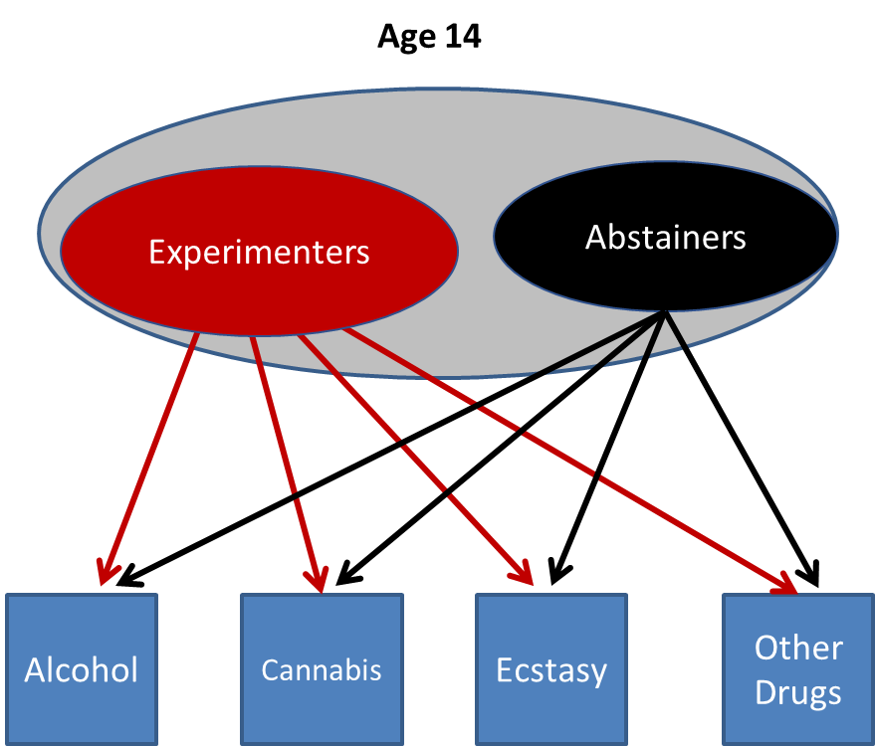
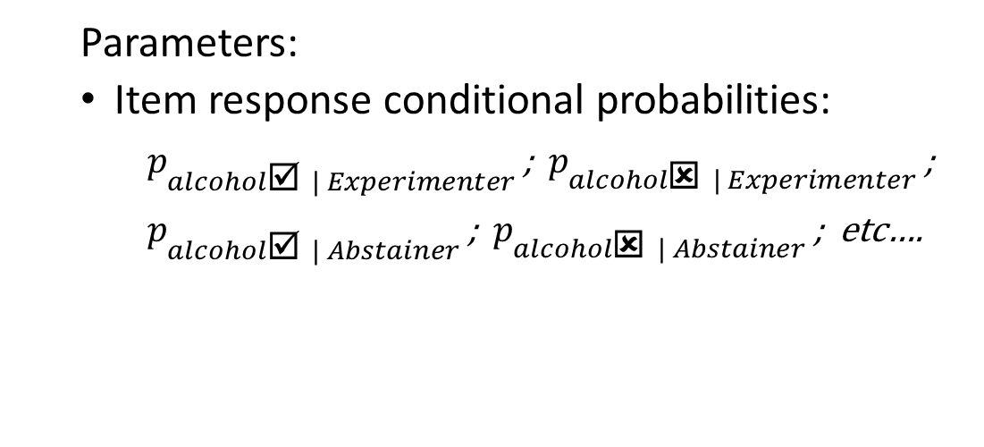
Stage 1: LCA solutions to data at different time points
Age 14
Age 15
  Parameters:
  Item response conditional probabilities:
    $p_{alcohol☑ | Experimenter }^{}$; ${ p}_{alcohol☒ | Experimenter }^{}$;
    $p_{alcohol☑ | Abstainer }^{}$; ${ p}_{alcohol☒ | Abstainer }^{}$; etc….
Alcohol
Cannabis
Ecstasy
Other Drugs
Notes:
A LC model will provide these parameters:
Firstly, the item response conditional probabilities, that is the probability, indicated by p, to report a type of behaviour in one indicator.e.g alcohol use, conditional on latent class membership. Here, for example, the p of reporting use of alcohol for people in the experimenter class, the p of reporting no alcohol use for people in the experimenter class, and so on.

Slide 9
Stage 1: LCA solutions to data at different time points
Age 14
Age 15
  Parameters:
  Item response conditional probabilities:
Indicators |  | Class 1 (Experim.) | Class 2 (Abstain.)
Alcohol | ☒ No | 0.15 | 0.93
Use | ☑ Yes | 0.85 | 0.07
Cannabis | ☒ No | 0.09 | 0.96
Use | ☑ Yes | 0.91 | 0.04
…etc…
Alcohol
Cannabis
Ecstasy
Other Drugs
Notes:
In LCA outputs, these probabilities will be reported in tables like this. Note that it is by inspecting these probabilities that we can interpret the meaning of the latent classes. For example, we see that individuals in latent class 1 have higher probabilities of reporting alcohol and cannabis use, those in latent class 2 have low probabilities of reporting use of these substances.

Slide 10
Stage 1: LCA solutions to data at different time points
Age 14
Age 15
  Parameters:
  Item response conditional probabilities
  Latent class prevalence;
  Posterior membership probability:
ID | Alc. | Can. | Xts. | Oth. | Class 1 (Experim.) | Class 2 (Abstain.)
101 | ☑ | ☑ | ☒ | ☒ | 0.95 | 0.05
102 | ☒ | ☒ | ☒ | ☒ | 0.02 | 0.98
103 | ☒ | ☒ | ☒ | ☑ | 0.46 | 0.54
…
Alcohol
Cannabis
Ecstasy
Other Drugs
Notes:
The other parameter provided by LCA is the prevalence of the latent class, i.e. how many individuals are likely to be in latent class 1 and how many are likely to be in latent class 2. Note that these are probabilistic, in fact LCA also provides posterior probabilities of latent class membership: that is, for each individual in the sample we can estimate the probability that the individual belongs to LC1 or LC2. So, an individual is assigned to a class with uncertainty. LC models vart in the degree of this uncertainty: some models may provide classifications that are more certain and precise (but not perfect). The statistic “Entropy” provides a measure of the classification precision, varying from 0, to 1, where 1 is a certain classification.

Slide 11
Stage 1: LCA solutions to data at different time points
Age 14
Age 15
Experimenters
Abstainers
Alcohol
Cannabis
Ecstasy
Other Drugs
Alcohol
Cannabis
Ecstasy
Other Drugs
Notes:
Spotlight on Age 15 now:

Slide 12
Stage 1: LCA solutions to data at different time points
Age 14
Age 15
Experimenters
Experimenters
Abstainers
Abusers
Abstainers
Alcohol
Cannabis
Ecstasy
Other Drugs
Alcohol
Cannabis
Ecstasy
Other Drugs
Notes:
Let’s assume that at this age there is more variability in behaviour patterns, therefore we identify an additional class of substance users, that of “Abusers”.

Slide 13
Stage 1: LCA solutions to data at different time points
Age 14
Age 15
Experimenters
Experimenters
Abstainers
Abusers
Abstainers
  Decide on the number of classes at each time point:
    Fit statistics: Pearson χ2 and Likelihood Ratio χ2 Comparisons;
    Tests comparing models with n and n-1 class: e.g. Bootstrap Likelihood-Ratio Test;
    Information Criteria: e.g. Bayesian Information Criterion (BIC);
    Entropy: Index of the precision of individuals’ categorisation into classes (range 0 to 1).
    Theory, substantive knowledge, plausibility of classes
Notes:
How should we decide the number of latent classes underlying behaviour patterns at each time point? There are a number of statistics we can use, and I talked about these in my resources on LCA. The main point is that, similarly to SEM, there is not a single statistic we can use, so we need to consider different ones. For example, the fit statistics compares the actual distribution with the distribution associated with the LC model, therefore low values indicate models that reproduce the observed data adequately. We can use tests that compare models with n classes, say 3, with models with n-1, say 2 classes: if the p value associated with the test is low, we can reject the model with n-1 classes. We can look at information criteria that consider fit statistics but penalize more complex models. We can also consider the Entropy statistic that indicates the precision of the classification afforded by the model.
One important point: since there are different statistics to consider and they rarely all agree on the best model, it is advisable at this stage of LTA to consider a pool of plausible models to investigate in further stages of the LTA, so that selection of the LC model at each time point can be informed by how the LC models perfume in other tests.
Also, it is important to consider theories and substantive knowledge, not just statistics, in investigating and selecting models.

Slide 14
Stage 2: Test measurement invariance

Slide 15
Stage 2: Test Measurement Invariance
Age 14
Age 15
Experimenters
Abstainers
Experimenters
Abstainers
Alcohol
Cannabis
Ecstasy
Other Drugs
Alcohol
Cannabis
Ecstasy
Other Drugs
Notes:
Let’s consider a simplified example. Let’s assume we are satisfied that two underlying classes adequately explain the observed pattern behaviours at age 14 and at age 15 years. These classes also appear similar, they appear to have a similar meaning, here experimenters and abstainers. We can regress the LC at age 15 on those at age 14 using multinomial regressions. However, since the two classes at age 14 and age 15 appear similar, can we plausibly assume they have the same measurement parameters at both time points?

Slide 16
Stage 2: Test Measurement Invariance
Age 14
Age 15
  Parameters:
  Item response conditional probabilities:
  Parameters:
  Item response conditional probabilities:
Indicators |  | Class 1 (Experim.) | Class 2 (Abstain.)
Alcohol | ☒ No | 0.15 | 0.93
Use | ☑ Yes | 0.85 | 0.07
Cannabis | ☒ No | 0.09 | 0.96
Use | ☑ Yes | 0.91 | 0.04
…etc…
Indicators |  | Class 1 (Experim.) | Class 2 (Abstain.)
Alcohol | ☒ No | 0.05 | 0.87
Use | ☑ Yes | 0.95 | 0.13
Cannabis | ☒ No | 0.01 | 0.91
Use | ☑ Yes | 0.99 | 0.09
…etc…
Notes:
The measurement parameters are the item response conditional probabilities. In this fictional example we can see they are not the same, but both two classes at each time point represent individuals that in LC 1 report higher probabilities to report substance use and in LC 2 report low probabilities of not using substances.

Slide 17
Stage 2: Test Measurement Invariance
Age 14
Age 15
  Parameters:
  Item response conditional probabilities:
  Parameters:
  Item response conditional probabilities:
Indicators |  | Class 1 (Experim.) | Class 2 (Abstain.)
Alcohol | ☒ No | 0.15 | 0.93
Use | ☑ Yes | 0.85 | 0.07
Cannabis | ☒ No | 0.09 | 0.96
Use | ☑ Yes | 0.91 | 0.04
…etc…
Indicators |  | Class 1 (Experim.) | Class 2 (Abstain.)
Alcohol | ☒ No | 0.05 | 0.87
Use | ☑ Yes | 0.95 | 0.13
Cannabis | ☒ No | 0.01 | 0.91
Use | ☑ Yes | 0.99 | 0.09
…etc…
Notes:
Can we assume that these differences may be trivial, and thus assume that the associations between latent classes and indicators is the same across time points? Namely, we can constrain the conditional probabilities of reporting use of alcohol if someone is in LC1 to be the same at age 14 and age 15. Similarly, we can constrain the conditional probability of reporting alcohol use for individuals in LC2 to be the same at age 14 and age 15 years. We impose equality constraints.

Slide 18
Stage 2: Test Measurement Invariance
Age 14
Age 15
  Parameters:
  Item response conditional probabilities:
  Parameters:
  Item response conditional probabilities:
Indicators |  | Class 1 (Experim.) | Class 2 (Abstain.)
Alcohol | ☒ No | 0.10 | 0.90
Use | ☑ Yes | 0.90 | 0.10
Cannabis | ☒ No | 0.04 | 0.93
Use | ☑ Yes | 0.96 | 0.07
…etc…
Indicators |  | Class 1 (Experim.) | Class 2 (Abstain.)
Alcohol | ☒ No | 0.10 | 0.90
Use | ☑ Yes | 0.90 | 0.13
Cannabis | ☒ No | 0.01 | 0.93
Use | ☑ Yes | 0.99 | 0.07
…etc…
Notes:
Once we have imposed these constraints the conditional item response probabilities are the same across time. This model with equality constraints is attractive for two main reasons: First, the number of parameters we need to estimate is reduced,. Second, this also facilitates interpretation of the model because the latent classes also have the same meaning.
But is a similar model with equality constraints plausible? Since the model with equality constraints is nested within the model where measurement parameters are freely estimated, we can compare the two models using a Likelihood-Ratio test, which provides a fomal test of the null hypothesis that the two models provide a the same fit. See the additional material and exercises provided for more guidance on LRT tests of measurement invariance.

Slide 19
Stage 2: Test Measurement Invariance
Age 14
Age 15
Experimenters
Experimenters
Abstainers
Abusers
Abstainers
Equality Constraints
Alcohol
Cannabis
Ecstasy
Other Drugs
Alcohol
Cannabis
Ecstasy
Other Drugs
Notes:
Here I am providing a more complex example: Even if at age 15 we identify an additional latent class, we might still consider plausible and test the hypotheses that the measurement parameters of a class, in this case the class I called “Abstainers” are the same across age. Again, using LR tests we can formally test this hypothesis. There may be many models we can test with partial measurement invariance: It is important that hypotheses on measurement invariance are guided by theory and substantive knowledge.

Slide 20
Stage 3: Extract latent classes parameters

Slide 21
Why not jump to Stage 4, impose structural relationships?
Age 14
Age 15
Latent Classes@14
Latent Classes@15
Alcohol
Cannabis
Ecstasy
Other Drugs
Alcohol
Cannabis
Ecstasy
Other Drugs
Notes:
In this stage I will illustrate how we can take the measurement parameters of the latent class models we have selected for each time points to then investigate the associations between these latent classes and changes across time.
But the question is then why do we need to do this? Why not jump to investigating the associations between latent classes while, at the same time, estimating the measurement model?

Slide 22
Why not jump to Stage 4, impose structural relationships?
Age 14
Age 15
Age 16
Latent Classes@14
Latent Classes@15
Alcohol
Cannabis
Ecstasy
Other Drugs
Alcohol
Cannabis
Ecstasy
Other Drugs
Educational Attainment
Notes:
The reasons for not jump to this stage can be glimpsed by considering what happens if we also added a distal outcome to the model, for example educational attainment at age 16. If we estimate the latent class models at the same time as the structural associations between latent classes and the regression of the distal outcome on LC at age 15, the LC model at age 15 is representing not just the covariance of the 4 substance use indicators but also the covariance of the distal outcome with the age 15 indicators. This means that while we may intend the LC model to explain the associations between the substance use indicators, the model is actually explaining the associations between indicators and educational attainment. In other words, by including a distal outcome, the model changes because the LC age 15 is also taking into account other covariances. This poses theoretical problems in interpreting the model, and practical problems: when we add a distal outcome the measurement model at age 15 will change its parameters.
The same problem arises when we include covariates.

Slide 23
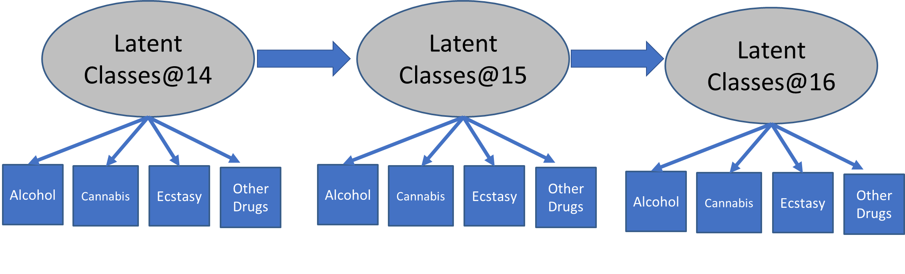
Why not jump to Stage 4, impose structural relationships?
  Substantive issue:
    Model interpretation when latent variables represent covariance in indicators and auxiliary variables (covariates, distal outcomes).
  Practical issue:
    Computational costs of estimating more complex models:
Gender
Notes:
So, I’d discourage the “parallel” estimation of the measurement model and the structural relationships because problems arise as soon as other variables are included in the model, and these problem include substantive problems in interpreting the model, and practical problems that become apparent when we have more time points, the models are more complex, and become really time consuming to estimate the models because of the computations necessary.

Slide 24
The 3-Step Approach
    Step 1: Estimate models and assign individuals to most likely class
    Step 2: Estimate measurement error (i.e., uncertainty in class allocation)
    Step 3: Impose relationships between different classes and covariates/distal outcomes, while controlling for measurement error in class assignment
Notes:
The solution that has been devised to this problem is a 3-step approach, which I will now discuss in more details.
The advantage of this approach is that the measurement models and the structural models are not estimated at the same time, but rather at different steps.
The measurement models are estimated and selected in the first step, and individuals assigned to their most likely class.
After that, we can assess measurement error in latent class, that is the uncertainty in latent class membership. Since latent class membership is estimated with error and is uncertain to some degree, it is important to control for this uncertainty to avoid biased results.
In the third step, we take individuals’ latent class membership accounting for measurement errors estimated in previous steps, and investigate the associations between classes as well as covariates and distal outcomes. Because we are not re-estimating the measurement model at the same time, the third steps only concerns the associations between latent classes and other variables, not the indicators.

Slide 25
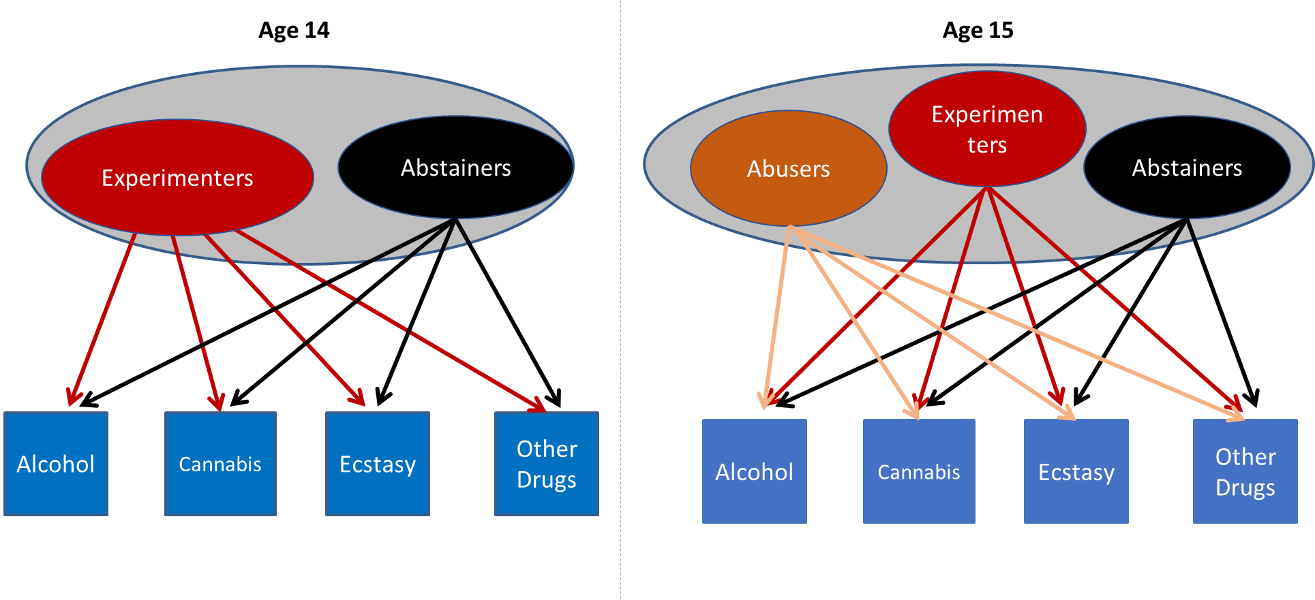
Step 1: Estimate Models and assign individuals to most likely class
Notes:
A practical example should help. So let’s assume that at each time point we have separately estimated these models where we identified 2 LC at age 14, and 3 at age 15. The issue may be complicated by measurement invariance, and in the exercises I provide more guidance on this.

Slide 26
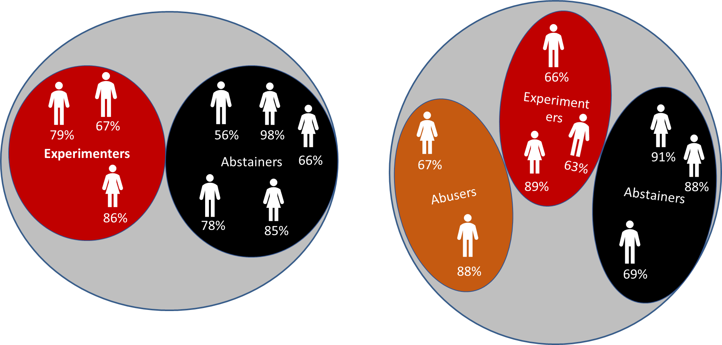
Step 1: Estimate Models and assign individuals to most likely class
Age 14
Age 15
Notes:
Having estimated the two measurement models at each time point, we assign individuals to an underlying LC based on their posterior probabilities.

Slide 27
Step 2: Estimate measurement error
(i.e., uncertainty in class allocation)
E.g.:
Average p of being “Experimenter” if assigned to “Experimenter” :
(.79+.67+.86) / 3 =
=.74
Average p of being “Abstainer” if assigned to “Experimenter”:
(.21+.33+.23)/3 =
= .26
Age 14
Notes:
Let’s focus on Age 14. Here we observe that 3 individuals are assigned to the LC “Experimenters”, and 5 are assigned to LC “Abstainers”, and you also see their respective probabilities to be in the respective LC.
If we take the 3 assigned to “Experimenters”, the average probability of being in LC “Experimenter” if they are “Experimenter” members is .79, etc. divided by 3. Since these probabilities add to 1, conversely, the average probabilities of being “Abstainer” when they are considered “Experimenter” members is .21…etc., so .26.

Slide 28
Step 2: Estimate measurement error
(i.e., uncertainty in class allocation)
E.g.:
Average p of being “Experimenter” if assigned to “Experimenter” :
(.79+.67+.86) / 3 =
=.74
Average p of being “Abstainer” if assigned to “Experimenter”:
(.21+.33+.23)/3 =
= .26
Assigned to ↓ | Av. p of being in Experim | Av. p of being in Abst. | N
Experim. | .74 | .26 | 3
Abstain. | .77 | .23 | 8
Age 14
Classification p of being in Experim. if assigned to Experim:
( .74 * 3 ) / [ (.74 * 3 ) + (.77 * 5) ] = .37
Classification p of being in Experim.. if assigned to Abstainer:
( .77 * 5 ) / [ (.74 * 3 ) + (.77 * 5) ] = .63
Log Odds of being correctly classified Experim. if assigned to Experim.:
LN (.37/.63) = -0.55
Notes:
We can report these probabilities in a table like this one. Considering the number of individuals assigned to each class, we can calculate the Classification probabilities of being an Experimenter if someone is considered an Experimenter member, which is:
. The product of the average probability of being experimenter if considered an experimenter member by the number of individuals assigned to the experimenter class.
. This is divided by the same product plus the product of average p of being experimenter if someone is considered an Abstainers by the number of Abstainers.
Once we have these classification probabilities, we can use these to calculate the odds of being experimenter if someone is considered an experimenter rather than an abstainer.
The logarithm of Odds represents in a single number the uncertainty in assigning participants to the class experimenter, how much we can be certain that those assigned to experimenters class are experimenters.

Slide 29
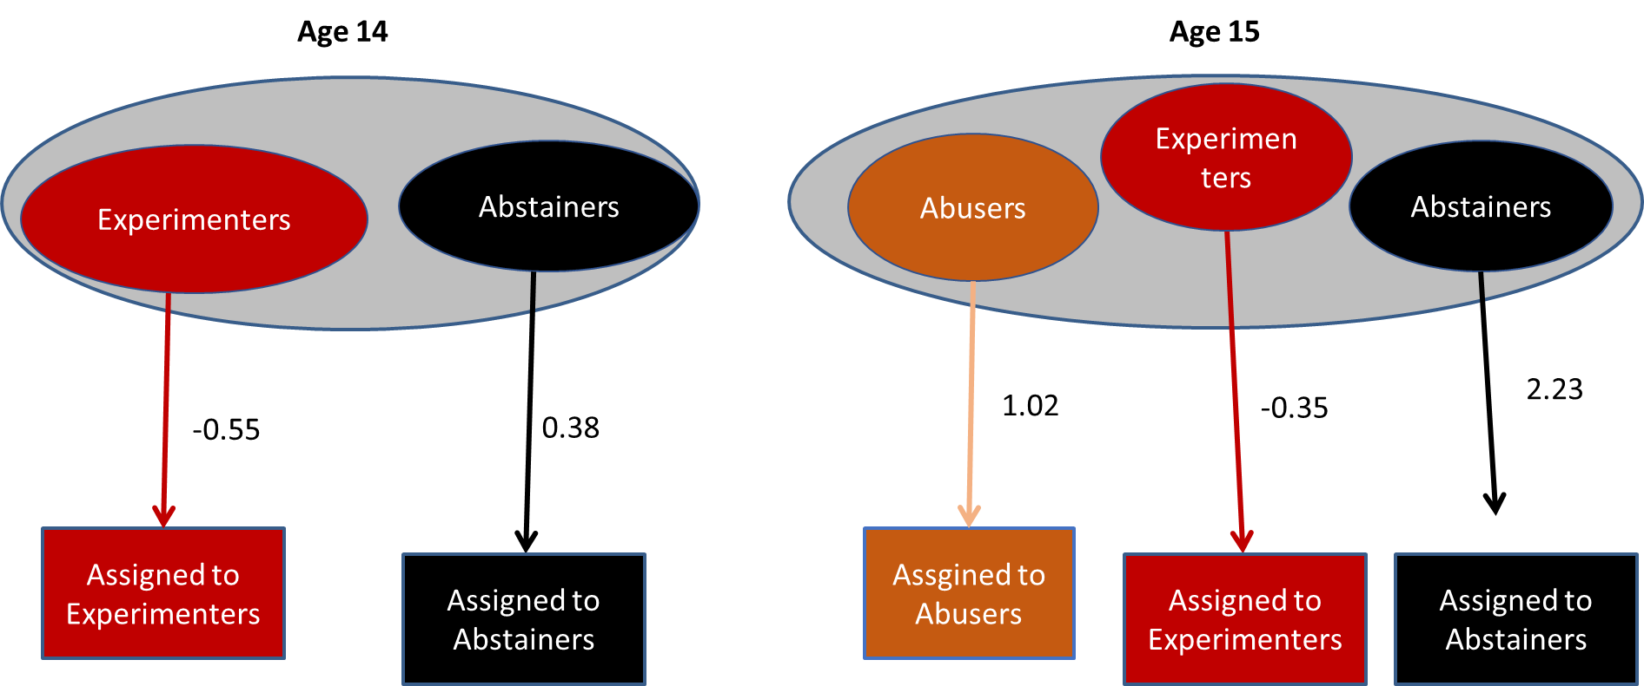
Step 3: Impose relationships between different classes, while controlling for measurement error in class assignment
Notes:
So, once we have calculated these odds, we can use the latent class membership as a nominal variable and use it to estimate latent class membership, fixing the uncertainty in this classification to the value of the log odds of being in one class if someone belongs to that class rather than the other one. In other words, we are “feeding” to the model the information about LC membership together with the information about the uncertainty in this classification represented by the log odds.

Slide 30
Step 3: Impose relationships between different classes, while controlling for measurement error in class assignment
Notes:
In this way, the measurement model here is fixed, it is not estimated anew, and we can investigate the associations between latent classes at different time points provided the measurement model we have selected as the optimal one to explain variability in response patterns across time.

Slide 31
Summary
Measurement Model:
  Investigate the number of classes necessary to explain heterogeneity separately at each time point.
  Test for measurement invariance.
Structural model:
  Use the 3-step approach to control for LC-membership uncertainty.
  Advantages: No need to re-estimate the measurement model; Less computational costs.
Notes:
To summarise, I have illustrated the first stages of LTA.
Firstly, we have to investigate the number of classes that adequately explain heterogeneity of behaviour. We estimate these classes separately at each time point.
We can then test for measurement invariance between classes when these classes appear to be similar.
Once we have selected one or a few optimal measurement models, we can extract the measurement parameters and use the 3-step approach to investigate the associations between latent classes across time and also other variables, as I will discuss in the third presentation.
I have highlighted that the advantages of the 3-step approach lie in the reduction of computation in testing LTA models, and there are substantial advantages in working with a given measurement model that has a given interpretation and is not re-estimated anew with every analysis.

Slide 32
www.ncrm.ac.uk

