Slide 1
Introduction to Bayesian Regression
Part #3
Dr Oliver Perra
Full resource: https://www.ncrm.ac.uk/resources/online/all/?id=20843

Slide 2
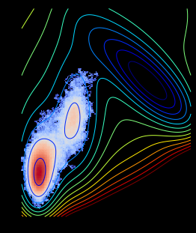
Markov Chain Monte Carlo (MCMC)
Algorithms to estimate posterior distribution of parameter values combinations.
  A series of random “walks” through parameter space;
  “Walks” follow a set of rules that ensures they will tend towards high probability regions of parameter space;
  “Walks” (a.k.a. Chains) should ensure an adequate exploration and representation of the underlying posterior distribution.
Notes:
The MCMC can represent the probability distribution over combinations of parameters by taking a series of random walks across the parameter space using a set of rules that ensure the walks will be more often in high probability regions. This ensures that at the end of these walks, called chains, the algorithm should have done a fair bit of exploration that ensures it can provide a reliable high-resolution description of the underlying posterior distribution.

Slide 3
Markov Chain Monte Carlo (MCMC)
Issues to consider:
  Chains can get stuck and fail to converge
  The chains may not be long enough to accurately represent the underlying distribution with high resolution.
An efficient variation is the Hamiltonian Monte Carlo (HMC) implemented in R through Stan and “Rethinking” package.
Notes:
The problem with algorithms such as these is that they can get stuck in some unrepresentative regions of the parameter space. So an important issue to check is that the algorithm converged. Another problem is that the solutions of the algorithm may not be stable, so they may provide solutions that are not well defined.
A version of the algorithm that has proved to be very efficient and reliable is the Hamiltonian Monte Carlo. This is implemented in R through Stan, and in a more approachable way through the “Rethinking” package.
An advantage of the HMC algorithm lies also in the fact that it will provide error messages when some key problems arise.

Slide 4
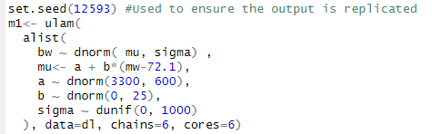
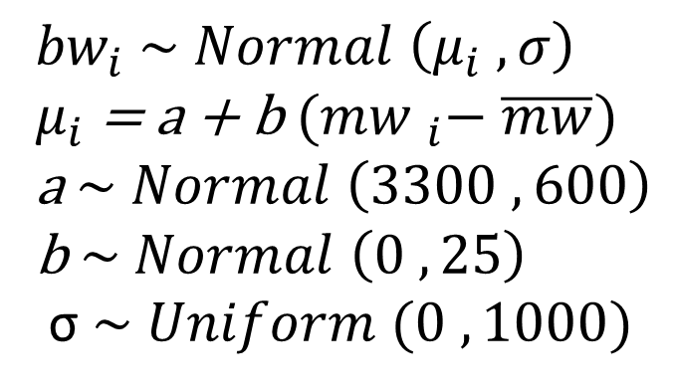
Linear Regression using HMC
Syntax using package “rethinking”
${bw}_{i}$ $\sim Normal \left(μ_{i} , σ\right)$
$μ_{i}$ = a + b ${(mw }_{i}− \overline{mw})$
a $\sim Normal \left(3300 ,600\right)$
b $\sim Normal \left(0 , 25\right)$
σ $\sim Uniform (0 , 1000)$
Notes:
Make sure the data include only the variables of interest in the model and these do not have missing values.
Note then number of chains and cores. It is recommended to invoke at least 4 chains.

Slide 5
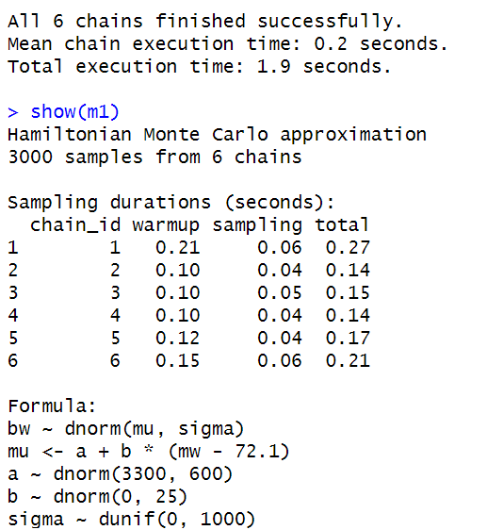
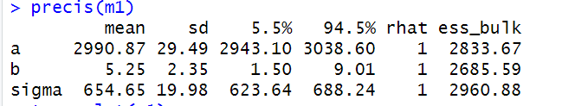
Linear Regression using HMC
Syntax using package “rethinking”
Notes:
No message errors
More information about the algorithm
The Rhat is an index of convergence of the algorithm,. It compares the between- and with-chain estimates for model parameters, so if they agree, the ratio is 1, as it is here. Rhat larger than one indicates issues with convergence, and the recommendation is that results should be used only if R-Hat < 1.05.
ESS_Bulk is the bulk effective sample size, which is an index of the stability of the algorithm. Bulk ESS should be at least 100 for each chain, so these results look good.
If you are publishing results, you should also report these diagnostic information, as recommended by Kruschke (2021).
Also, you should inspect the process of the algorithm to check for issues and diagnose potential problems. Chapter 9 of McElreath book provides clear guidance on these diagnostics, and the R script also shows some examples.
The command precis also provides a table of the estimated parameters. For example, the average mean of newborn’s birthweight for women of average weight is 2,990 g, with a SD of 29 g. For each kg of maternal weight, the baby’s birthweight is estimated to increase by 5 g, and this effect has a SD equal to 2 g. You can also see the 89% credibility interval, which tells that the slope in this model has 89% probability of being between 1.50 and 9 g. Note the difference in interpretation of credibility intervals and confidence intervals.

Slide 6
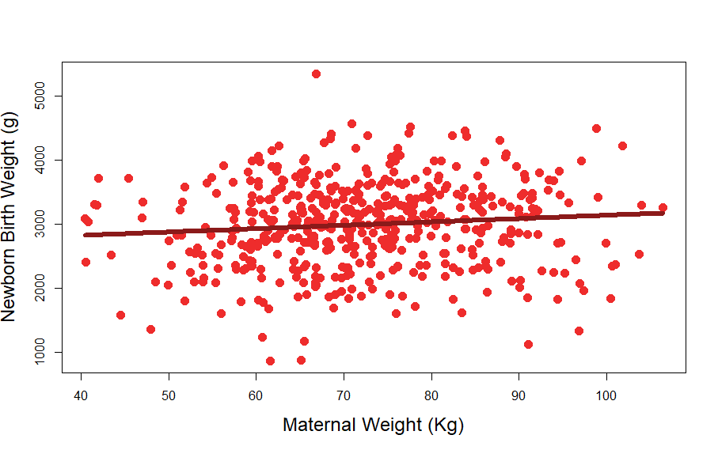
Linear Regression using HMC
Plot the posterior inference against the data
Notes:
Plots are very important in providing information about the results, particularly when the models are more complex (e.g. include interactions). Plots also provide a way to informally check on the model assumptions.
In this graph, the dots represent the scatter of observed data where on the horizontal axis I report maternal weight in Kg, and the vertical axis represents newborns’ weight in grams. The darker line is the slope that represents the mean intercept “a” and the mean slope “b”. You can follow I built this graph in the script attached.
One thing to keep in mind however is that in Bayesian regression this is just the most plausible line that links the two variables, but there are many other lines that the model has ranked for their plausibility, and that have high plausibility.
So we can make the most of Bayesian analysis and not focus our inference only on one value, as it happens with frequentist statistics. The posterior distribution considers every possible regression line and assigns relative plausibility to each. Therefore, there may be many other lines that have similar plausibility than the average line shown here, and we need to explore the posterior probability of different combinations of parameters “a” and “b”.

Slide 7
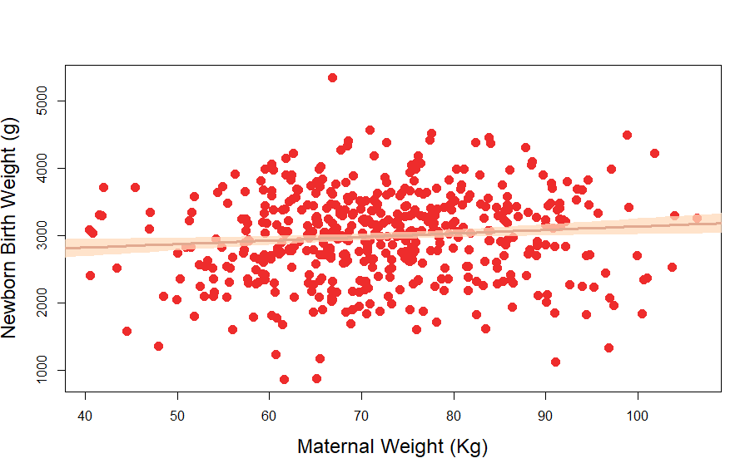
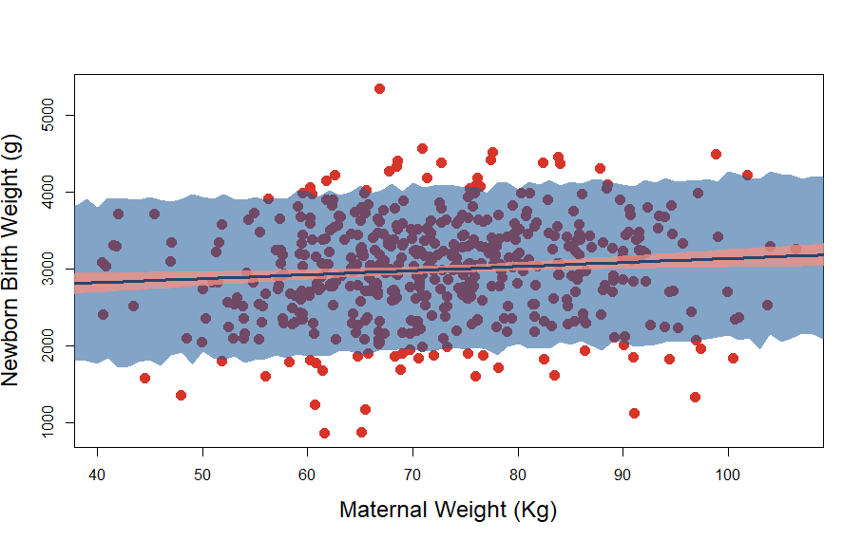
Represent uncertainty
Notes:
Plots can provide information regarding uncertainty in the parameters, as well as the uncertainty in predictions of the model. The plots can provide this information in a more intuitive and tangible way.
For this purpose, we can sample from the posterior distribution: the posterior distribution represents the relative probability of different combinations of parameters, so we can use this to extract large random samples. After extracting these unbiased samples, we can use them to investigate the distribution more closely.
For example, we can take a large sample from the posterior, and use it to describe the uncertainty around the central value in the posterior, the mean. In this first graph I have done that, whereby the shaded pink area represents the 89% Credibility Interval of the mean.
Then again, the posterior distribution, being a probability distribution of every possible combination of parameters, can also be used to investigate the uncertainty in the actual outcome predicted by the model, the birth weights. Once again, this is useful if you are interested in more aspects of the model and can help to informally test how well the model fits the data. In this second graph, I have added a shaded area that represents the uncertainty in the predicted birth weights: the shaded area represents the 89% posterior prediction interval of observable birthweights across the values of maternal weight.

Slide 8
Advantages of Using Bayesian Regression
Incorporate previous knowledge in models:
  Capitalise on previous research;
Formalised assumptions; transparently reportable;
Small samples provide valid estimates;
More intuitive interpretation of estimates, e.g.:
  Range of mean values with 89% prob.;
  Range of actual outcome values with 89% prob.;
All combinations of parameters ranked for their plausibility (conditional on data and model).
Notes:
Incorporating previous knowledge makes for more sensible models and the opportunity to capitalise on the body of research that exists.
Assumptions are formalised and therefore not usually accepted by default. They can also be easily reported and communicated using the type of notation used in these presentations.
Every piece of information or data, however small, provide valid estimates. This is because, unlike in the standard approach, estimation is not based on assumptions of underlying sampling distributions that are only plausible when samples are large, the so-called “asymptotic” behaviour. However small a sample, Bayesian estimates have a clear and valid interpretation. The caveat is that if the sample is small, the estimates are more dependent on the prior: if the prior is a bad one, the resulting estimates based on small samples will be misleading.

Slide 9
www.ncrm.ac.uk
Notes:
The cons of Bayesian regression are probably the difficulties in implementing the analyses: there are more decisions to make, more considerations as to what priors should be used, decisions about the running of the algorithm, sensitivity analyses to be run to check the influence of priors and the convergence and reliability of algorithms. However, I think the benefits outweight the cons, and Bayesian regression is a powerful tool to make better science.
This was a quick introduction, but it is relatively easy to build more complex models with more predictors, interactions between predictors, and different assumptions regarding the distributions of parameters. In the exercises you will find some examples, and I also refer to the references attached to this module.

