Slide 1
An Introduction to Bayesian Regression
Part #1
Dr Oliver Perra
Full resource: https://www.ncrm.ac.uk/resources/online/all/?id=20843

Slide 2
Summary
Bayes vs. Frequentist approach
Advantages of a bayes approach

Slide 3
Bayesian approach
A different view of hypothesis testing from traditional approach:
  Allows to include previous knowledge on the phenomena
  Incorporates every piece of new information (however small) to update our knowledge in light of new evidence.

Slide 4
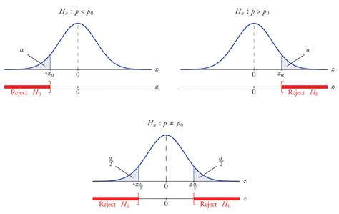
Conventional Methods (Frequentist)
  Parameters (e.g.: population mean) are unknown but fixed.
  A counter-factual approach:
    Null hypothesis
    Estimate probability of observed difference occurring from null hypothesis if we replicated the experiment several times.
Notes:
Parameters are measurable characteristics of a population, eg the mean IQ of adults in a country.
The conventional approach to hypothesis testing assumes that parameters are unknown, but are fixed.
For this reason, conventional methods take a counter-factual approach.
Say we experimentally tested a training programme and wanted to know if it makes our participants smarter. We test the difference between the IQ of our trained participants and that of untrained ones assuming a counterfactual scenario where the difference between these means is exactly 0, or else, the two groups have exactly the same average IQ.
Based on this counterfactual scenario, the statistical methods estimate the probability that our observed difference in IQ occurred from the null hypothesis, and this scenario is estimated assuming that we replicated the experiment several times, or else.
If the observed difference is unlikely to have been generated from the null hypothesis scenario, we can reject the null hypothesis that there is no difference and say that there is a difference in the means of the two groups.
So, one problem is that the p value is defined in a scenario where we assume we can repeat the study several times. The process that generates the data is supposed to be repeatable.
But this is not always the case, nor is it always possible. For example, in meta-analysis, the collection of studies should be considered as a one-off.
There is also a problem in interpreting the p value and the results. Assume that our control group had IQ=100. If the p value of our test of mean differences was .01, lay people tend to assume there is only 1% probability that the mean of our trained sample is also 100. This is incorrect though, because the p values represent the probability that we will fail to reject the null hypothesis of no difference between trained and control if -in reality- there was no difference between the average IQs of the two groups. So the results do not inform about the probability of the parameter of interest, e.g. the probability of average IQ for the trained participants being 100.
Another problem is that with larger samples and increased estimate precision, it becomes more likely we can reject null hypotheses. So, in large studies we can have significant effects that are relatively unimportant or inconsequential.
A further problem is that we can assume that data from the hypothetical repetition of the study will follow known distributions if our samples are relatively large. With small samples, the underlying sampling distributions may be unknown, and we may not be able to use information collected, unless we make great leaps of faith.

Slide 5
Bayesian Analysis
  Parameters are uncertain:
    Described by probability distributions.
  A-priori assumptions about the distribution of a parameter are updated considering new data:
    Estimate posterior distributions that take into account new information.
    Sample from posterior distribution to summarise parameter plausible values and their uncertainty.
Notes:
In the Bayesian approach parameters are not fixed, but instead they are variables, measurable population characteristics that are uncertain. If they are uncertain, they can be described by a probability distribution, in other words, we can estimate the plausibility that a parameter like a population mean is a certain value or else, lies between a specific range of values, and so on.
How can we do this? The analyses start from a-priori assumptions on the distribution and values of a parameter. This assumptions may be based on previous knowledge or previous research. They may be wide: in the example of a group IQ, we could assume that the average IQ of a group of trained people will be between 70 and 230 and assume that any value between these two extreme is equally likely to be the average of our trained group.
The a-priori distribution is updated considering the new data we have collected. With the information collected by our study we can update the probability distribution of the parameter, giving more credibility to some values rather than others, conditionally on the evidence we have. For example, the information collected may show it is very unlikely our participants’ average IQ is 70. The updated probability distribution of parameter values is called “posterior” because it is estimated after seeing the data.
Once we have estimated a posterior distribution of the plausible values the average IQ can take, we can sample from this probability distribution to describe means and medians of the probability distribution, i.e. what is the most plausible value the parameter may take, or to describe the range of parameter values that are more likely, based on the estimated posterior distribution.
Bayesian analysis is basically a formal way to update models of the world by using evidence. If there are two candidates in an election, we can ask our friends who they intend to vote. Based on these answers, we form some expectations. We may then read some polls, and based on these results, we update these expectations. If the polls have a large random sample, the data will shift our prior beliefs to more defined beliefs about who’s going to win. Bayesian analysis provides a formal way to define how this update should take place.
An example will make this clearer

Slide 6
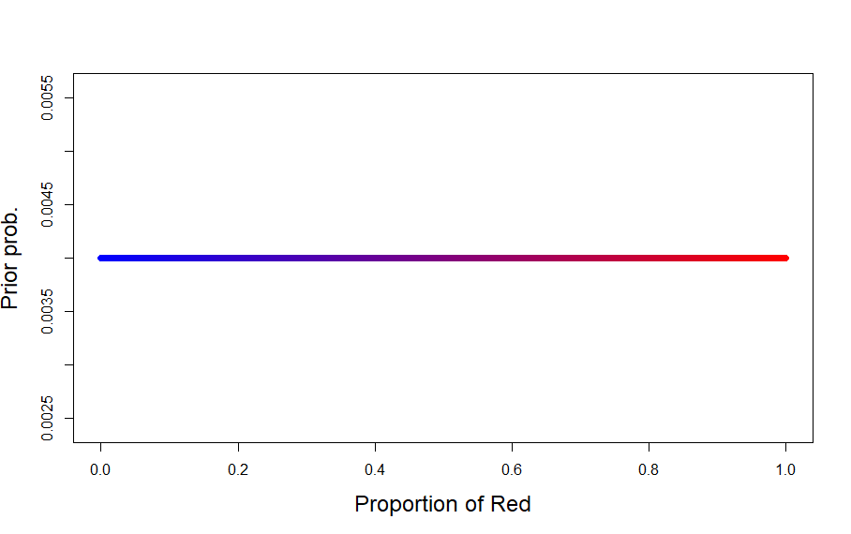
Bayesian analysis
  First element: A prior
Prior
DATA:
R=3
N=5
R/N = 0.60
p = proportion who will vote Red
H = number of respondents who indicate Red preference
N = total number of respondents
Notes:
Let’s consider a similar dichotomous outcome. There is going to be an election and there are two candidates, Blue and Red. Let’s assume that null votes or abstention is not possible, so there are only two possible outcomes, either vote Blue or vote Red.
In this scenario, I have three variables, things that can take different values.
One variable is the proportion of people that will vote Red, which I call “p”. “p” is a parameter: I want to get a plausible estimate of what is the proportion of people that will vote for red candidate, but I cannot observe this yet. However, I can infer it by collecting other information, other variables.
The other variables here are the number of people that intend to vote the red candidate, and the total number of people I interviewed.
If I don’t know anything about the constituency and the candidates, I may start by assuming that any type of outcome is equally plausible. This is the first element in a Bayesian model, a prior.
This graph represents my prior: The horizontal axis represents the range of possible values: p=0 indicates that everyone will vote for Blue, and p=1 indicates that everyone will vote Red. The flat line between these two extremes means I am giving equal credibility to these different parameter values, so that I am assuming that everyone voting for Blue is as likely as the votes being split exactly equally, or everyone voting for red. This flat line is basically saying that any combination of preference for Red and Blue is equally plausible in my naïve opinion.
But if I start by asking 5 people at random, I may see that the red candidate has a larger proportion of preferences. How can I update my beliefs?

Slide 7
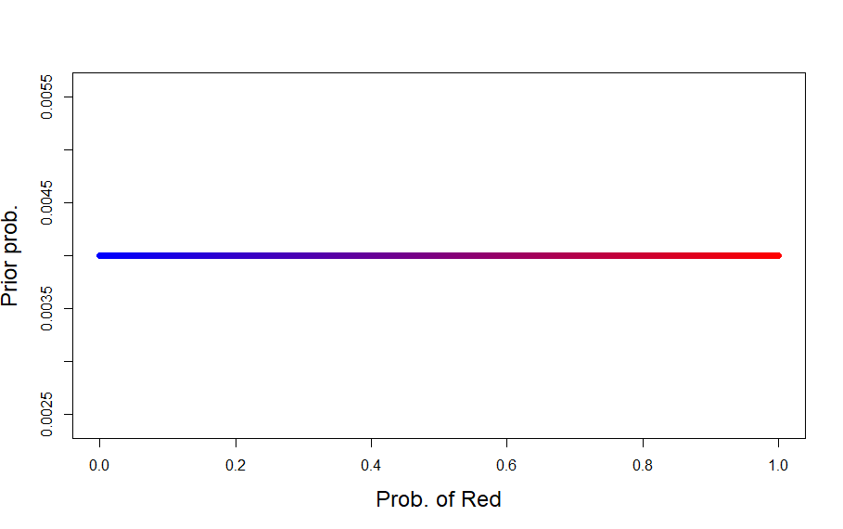
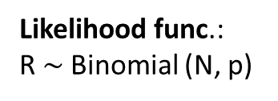
Bayesian analysis
  Second element: Likelihood function.
Prior
My prior assumption
DATA:
R=3
N=5
R/N = 0.60
Likelihood func.:
R $\sim$Binomial (N, p)
p = proportion who will vote for Red candidate
R = number of respondents who intend to vote for Red
N = total number of respondents
Notes:
Now I have some observed variables and I want to update my beliefs and estimate how plausible different combinations of preferences for Red and Blue are. The function to reassign plausibility values to p is a likelihood function. The likelihood function is the second element in the analysis. This function represents the most likely values of the parameter given the data. In other words, it is a mathematical function that tells me how the data observed may have come about. In this example, the likelihood may take the form of a binomial distribution. This is saying that the number of preferences for Red will be approximately distributed according to a binomial distribution with N representing the number of respondents, and p representing the uncertain parameter va;ues I want to estimate. This formula is basically reporting the likelihood that respondents will express a preference for Red , given N observation and the parameter, and thus represents how the variables relate with the model parameters to create the data.

Slide 8
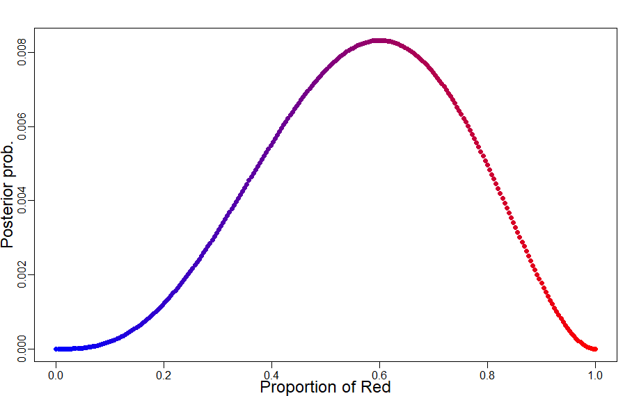
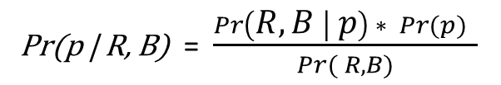
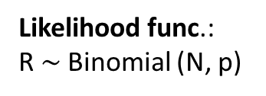
Bayesian analysis
  Bayesian Rule→ Posterior
Posterior
Prior
DATA:
R=3
N=5
R/N = 0.60
Likelihood func.:
R $\sim$Binomial (N, p)
Posterior:
Pr(p | R, B) = $\frac{\operatorname{Pr}\left(R, B | p\right) ∗ Pr⁡(p) }{Pr⁡( R, B)}$
p = proportion who will vote for Red candidate
R = number of respondents who intend to vote for Red
N = total number of respondents
Notes:
Now I have prior assumptions, data, and a likelihood function that tells me how different values of the unknown parameter may generate the data I have observed. So, how I can use all this information to provide an updated description of the plausibility of different parameters values ?
For this purpose, I use the Bayes theorem, which states that the probability of any particular value of p considering the data, is equal to the product of the relative plausibility of the data conditional on p and the prior value of p. This product is divided by the average probability of the data.
The key issue is that the posterior is proportional to the product of the prior and the likelihood of the data.
You can check the script I have used to create this example with the material provided to see that effectively this means firstly calculating the likelihood of my observed data conditionally on the range of values of the parameter p, from 0 to 1, e.g. what is the probability of R=3 out of N=5 if p=0, what is the probability of 3 Red out of 5 draws if p=.01, and so on. This is multiplied by the prior probability of p, the probability that I had assumed different values of p will have, and then is divided by the sum of all the products of the likelihood by the prior.
This will create this updated distribution of probability represented here, where the plausibility has been re-allocated.
The mean of this posterior shows that the most plausible parameter value is very close to 0.60, which is the observed value in this small sample, but you can also see that many other parameter values like 0.50 are also quite plausible, according to this posterior. This is because with only 5 participants, we shouldn’t reallocate the credibility of the parameters too narrowly: an observed result of 3 votes for Red out of 5 could have easily been generated by parameter being 0.50 or 0.70.

Slide 9
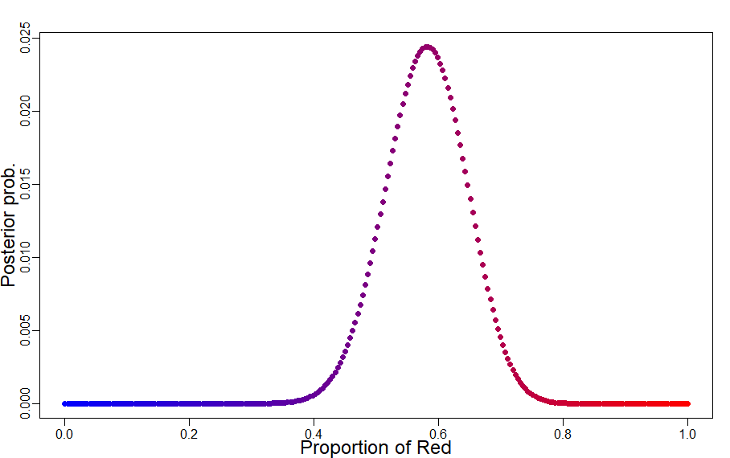
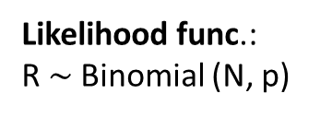

Bayesian analysis
New Data:
R=29
N=50
R/N = 0.58
Prior
Posterior
Likelihood func.:
R $\sim$Binomial (N, p)
Pr(p | R, B) = $\frac{\operatorname{Pr}\left(R, B | p\right) ∗ Pr⁡(p) }{Pr⁡( R, B)}$
p = proportion who will vote for Red candidate
R = number of respondents who intend to vote for Red
N = total number of respondents
Notes:
If I collect more interviews from a new random sample of 50 participants, I can work from my previous model where the plausibility had been re-allocated. This means my prior is more precise here, based on my previous updating. And why should it not be the case? Should I have worked from the assumption that 0 votes for Red was as likely as other combinations when my previous data showed that this was already a very unlikely event since some of the people in the sample already expressed an intention to vote for Red?
So using the same methods, I can update the previous assumptions to reallocate the plausibility of p values considering the new data. This narrows the posterior distribution as you can see here.
This analysis allowed me to update the relative credibility of the parameter values in ways consistent with the new data. This updated attribution of credibility to a range of parameter values is useful if my data are not biased, e.g., my sample is representative of the population of interest, but this type of bias is not a statistical problem.

Slide 10
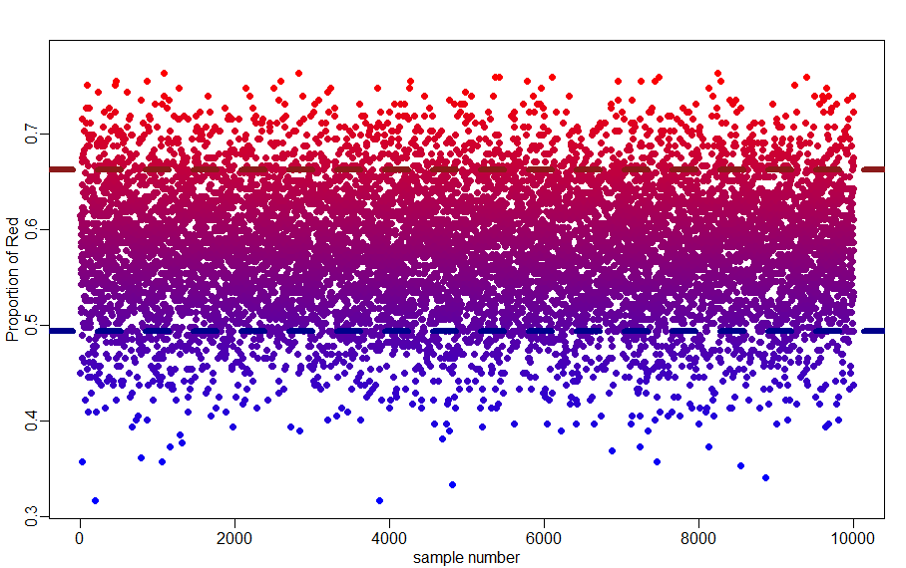
Sampling to summarise
Posterior
p = proportion who will vote for Red candidate
R = number of respondents who intend to vote for Red
N = total number of respondents
90% of prob. of Red between 49.40% and 66.26%
Notes:
This Posterior is a probability distribution describes the credibility of the parameter p considering the data we have collected and previous assumptions, the model. The prior plays an important role in avoding our models getting too skewed and too narrow by new data. I will talk more about this in the second presentation.
But once we have a posterior distribution, we can use it to create large random samples that allows to describe model information..
In other words, if the posterior is describing the plausible values of the parameter, I can draw random samples from this distribution, which, being unbiased, provide a reliable description of the underlying distribution.
You can follow the script I have used, provided with the material. In the script I drew 10k random samples from the posterior distribution, and I represented them here. You can see that most of these cases cluster around the p values between 0.4 and .75. Indeed, 90% of the sample lies between values that indicate a 49.40% and 66.26% preference for Red, these two values represented by the dotted horizontal lines. That is, I can estimate that there is 90% probability that the rate of votes for the Red candidate will be between 49% and 66%.
The Median value is 57.83%. The main point is that the posterior distribution provides a measure of relative plausibility of all combinations of parameter values given the model and the data. In the posterior distribution, all possible values of parameters are ranked by their logical plausibility. In the second presentation I will illustrate how these methods can be applied to a regression model.

Slide 11
Bayesian Analysis
  Bayesian analysis “takes a question in the form of a model and uses logic to produce an answer in the form of probability distributions” (McElreath, 2018: Page 10)

Slide 12
www.ncrm.ac.uk

