Slide 1
CCUS Conversation game
Facilitator guidelines

Slide 2
Set-up Playing mat – one per player

Slide 3
Set-up Information sheet one per player

Slide 4
Cards
32 Info cards
32 Issue cards
16 Story cards
8 Challenge cards
8 Warning cards

Slide 5
Card structure
Climate change
(1-4 story, 1-8 info, 1-8 issue cards)
CCUS
(5-8 story, 9-16 info, 9-16 issue cards)
Impacts
(9-12 story, 17-24 info, 17-24 issue cards)
Communities
(13-16 story, 25-32 info, 25-32 issue cards)
Either randomly mix cards or distribute evenly to each player.

Slide 6
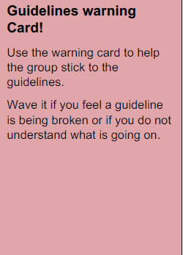
Set-up explain guidelines
Explain the conversation guidelines that are also written on the play mat
Give each player a warning card they can use if they feel someone is breaking the guidelines (e.g. talks too much).
Tell them they can use the information sheet if there are any terms they don’t understand

Slide 7
Phases of the conversation game
Phase 1 Information (+-30 Minutes)
Phase 2 Discussion (+-30 Minutes)
Phase 3 Group view (+-30 Minutes)
Phase 1 and 2 often overlaps so can be done together.

Slide 8
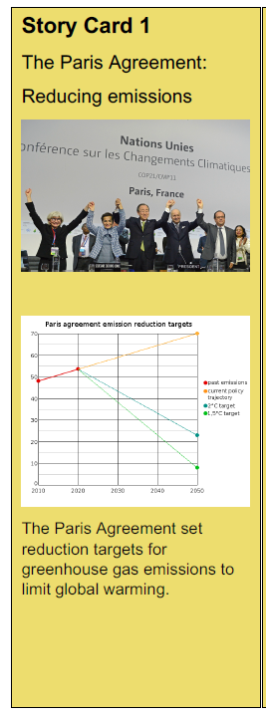
Phase 1A – Story cards Max 20 minutes
Story cards
Distribute the story cards evenly to each player
Spare cards can be laid in the middle
Players should look at the frontpage and choose 1 story card to read in depth
They can lay down and pick up cards from the middle
Once everyone is finished they can tell about the story card they read

Slide 9
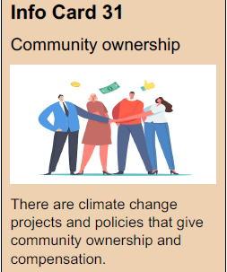
Phase 1B Info cards Max 20 minutes
Distribute the info cards evenly to each player
Spare cards can be laid in the middle
Players should look at the frontpage and choose 2 Info cards to read in depth
They can lay down and pick up cards from the middle
Once everyone is finished they can tell about the info cards they read

Slide 10
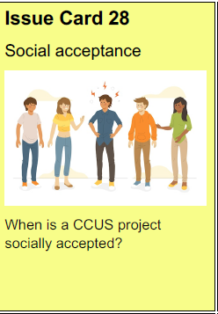
Phase 1C Info cards Max 20 minutes
Info cards
Distribute the issue cards evenly to each player
Spare cards can be laid in the middle
Players should look at the frontpage and choose 2 issue cards to read in depth
They can lay down and pick up cards from the middle
Once everyone is finished they can tell about the issue cards the have chosen

Slide 11
Phase 2 Discussion If separate – 30 minutes
Might happen together with phase 1.
Else, the group should discuss the cards they have chosen.
They can add their own cards with info, issues or story on the play mat (but rarely happens)
The challenge cards can be given to them to stimulate discussions

Slide 12
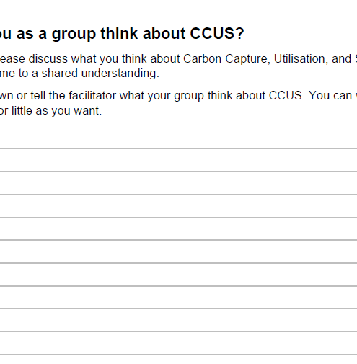
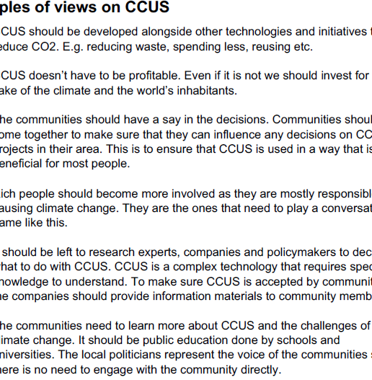
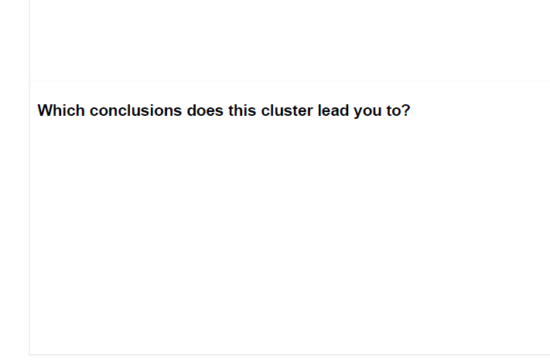
Phase 3 Group view 30 Minutes
Give each group
Cluster sheet
Group view sheet
Other people’s view (if they are unsure about what to write and talk about)
The group can write down their group view and/or recommendations
Alternatively they can tell it to the facilitator

Slide 13
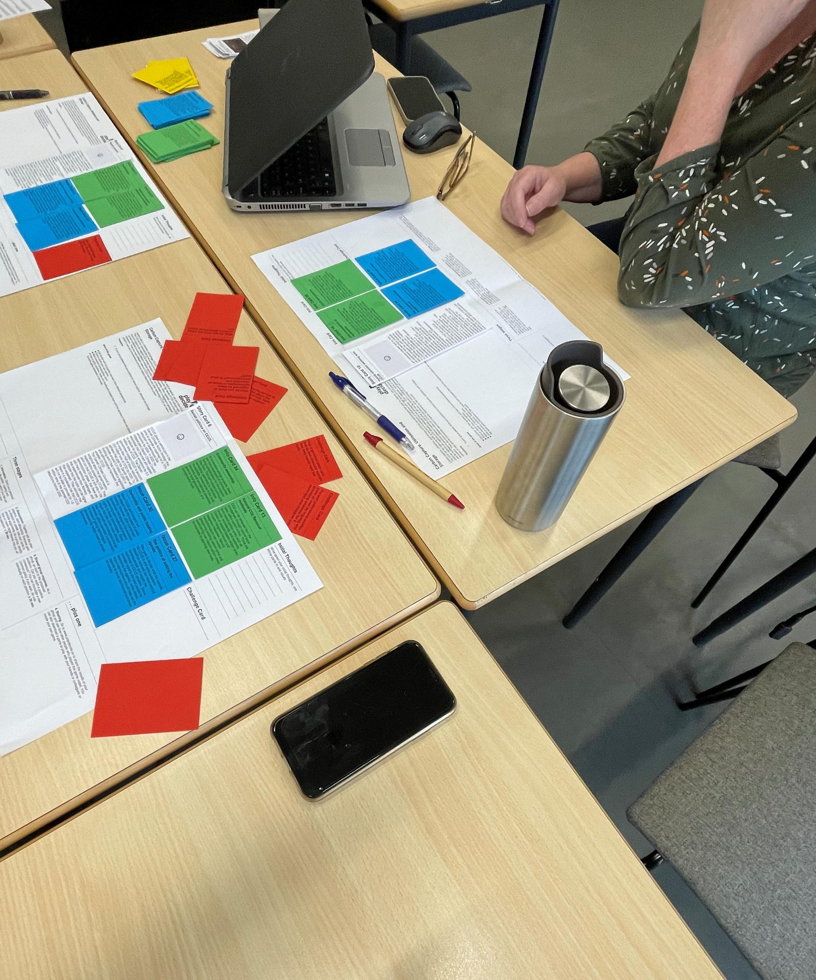
Post-game
If possible please
Take a picture of the playing mat with chosen cards
Either
Take a picture of the group view sheet
Keep it to give to give it to us later
Write up the group view

Slide 14
Thank you for your help!

